Slide 1
Curso - Data Science Math Skills (Coursera)
Evidencias

Slide 2
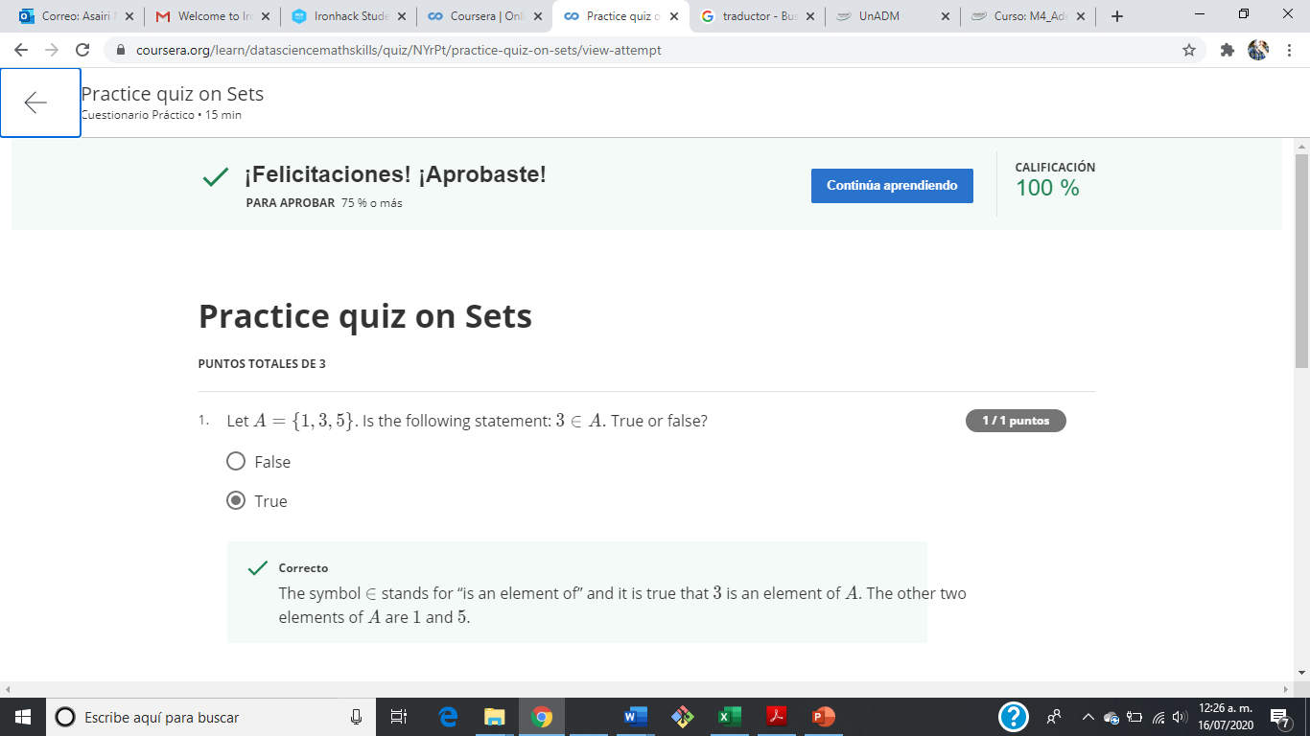
Evidencia – Building Blocks for Problem Solving – Practice quiz on sets.

Slide 3
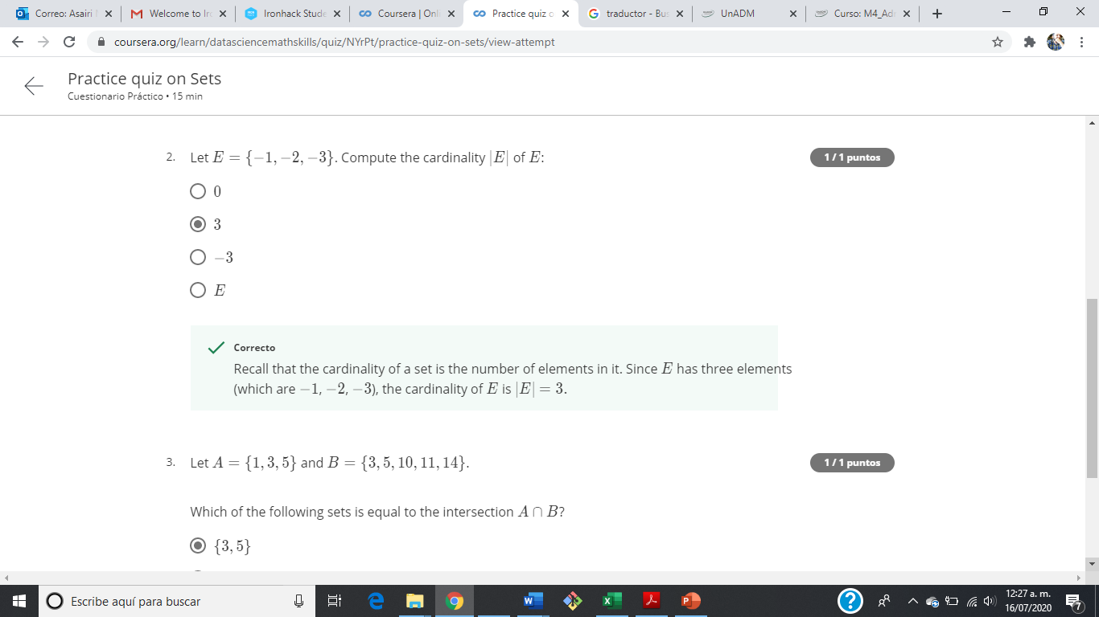
Evidencia – Building Blocks for Problem Solving – Practice quiz on sets.

Slide 4
Evidencia – Building Blocks for Problem Solving – Practice quiz on sets.

Slide 5
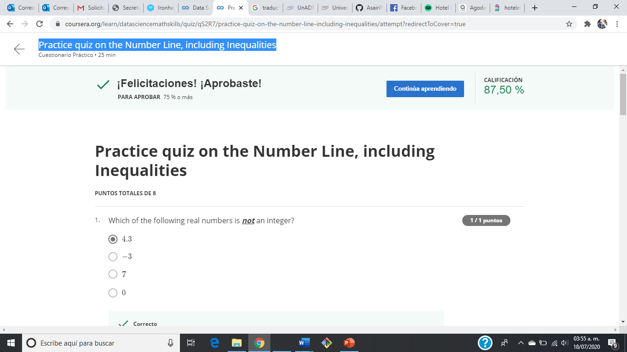
Evidencia – Practice quiz on the Number Line, including Inequalities

Slide 6
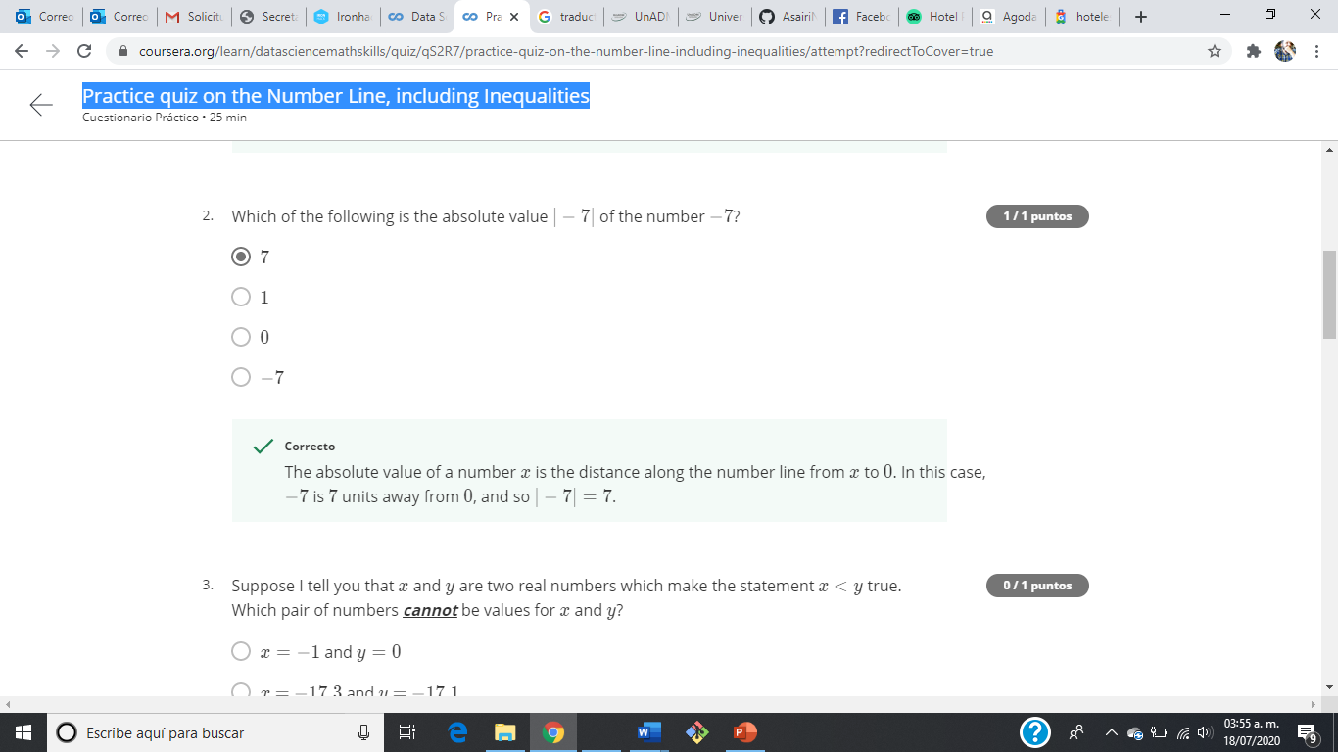
Evidencia – Practice quiz on the Number Line, including Inequalities

Slide 7
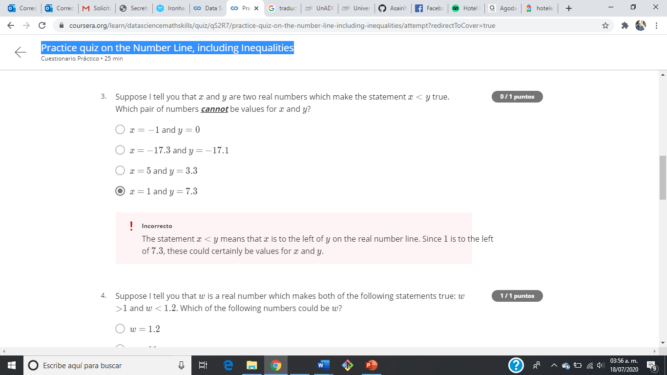
Evidencia – Practice quiz on the Number Line, including Inequalities

Slide 8
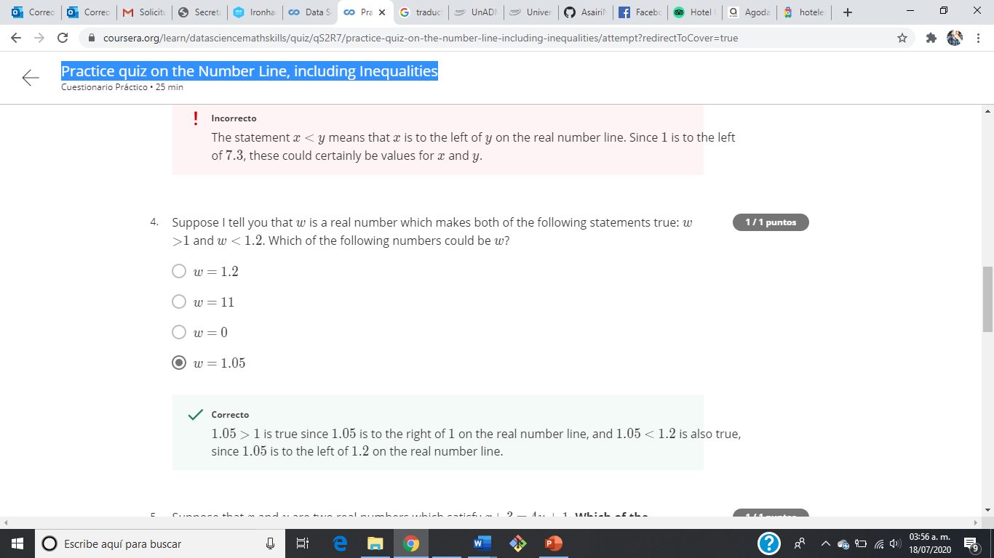
Evidencia – Practice quiz on the Number Line, including Inequalities

Slide 9
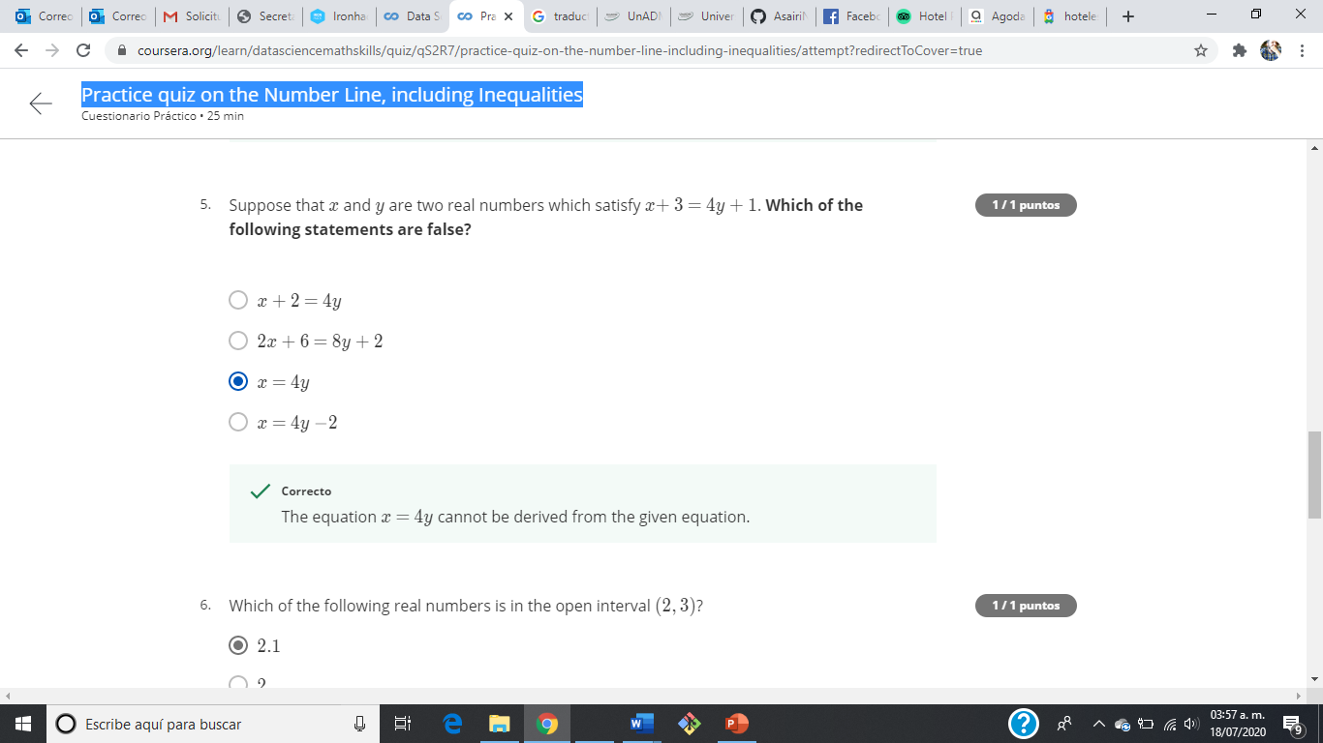
Evidencia – Practice quiz on the Number Line, including Inequalities

Slide 10

Evidencia – Practice quiz on the Number Line, including Inequalities

Slide 11
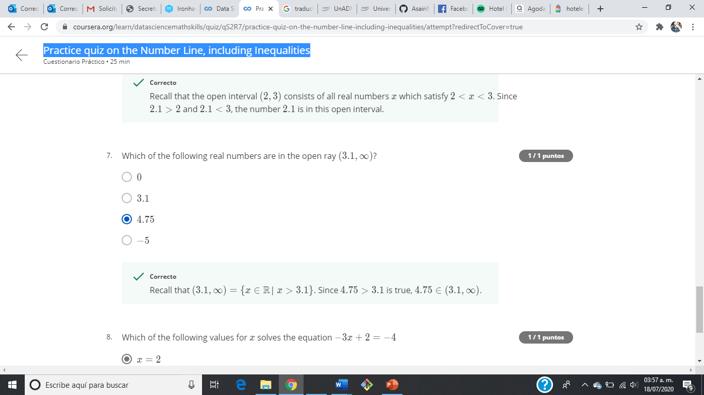
Evidencia – Practice quiz on the Number Line, including Inequalities

Slide 12
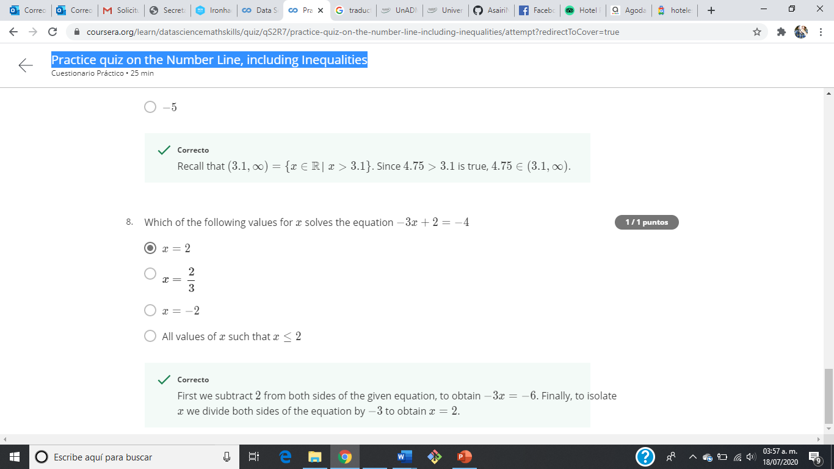
Evidencia – Practice quiz on the Number Line, including Inequalities

Slide 13
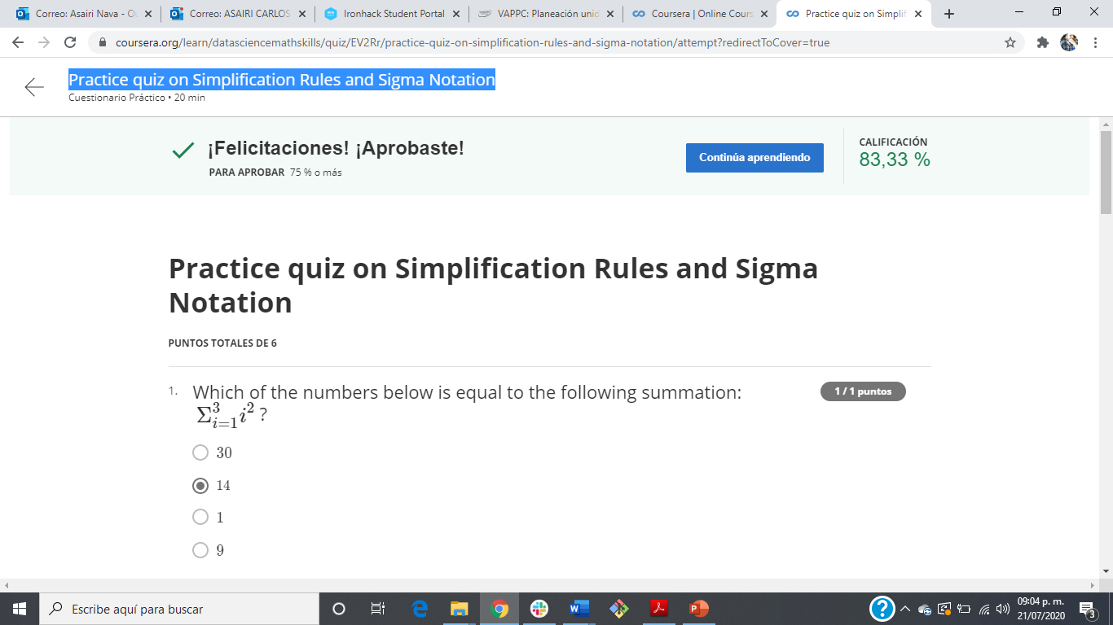
Practice quiz on Simplification Rules and Sigma Notation

Slide 14
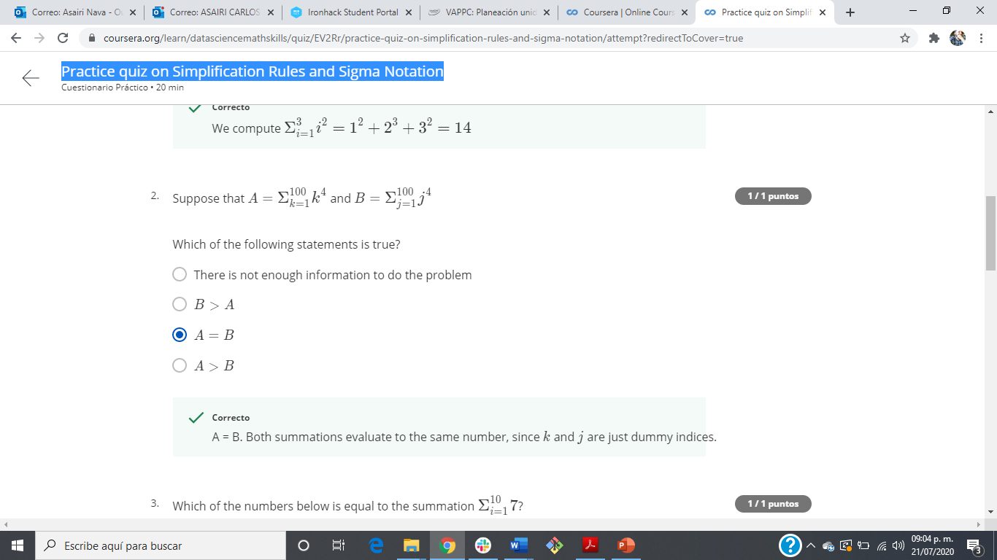
Practice quiz on Simplification Rules and Sigma Notation

Slide 15
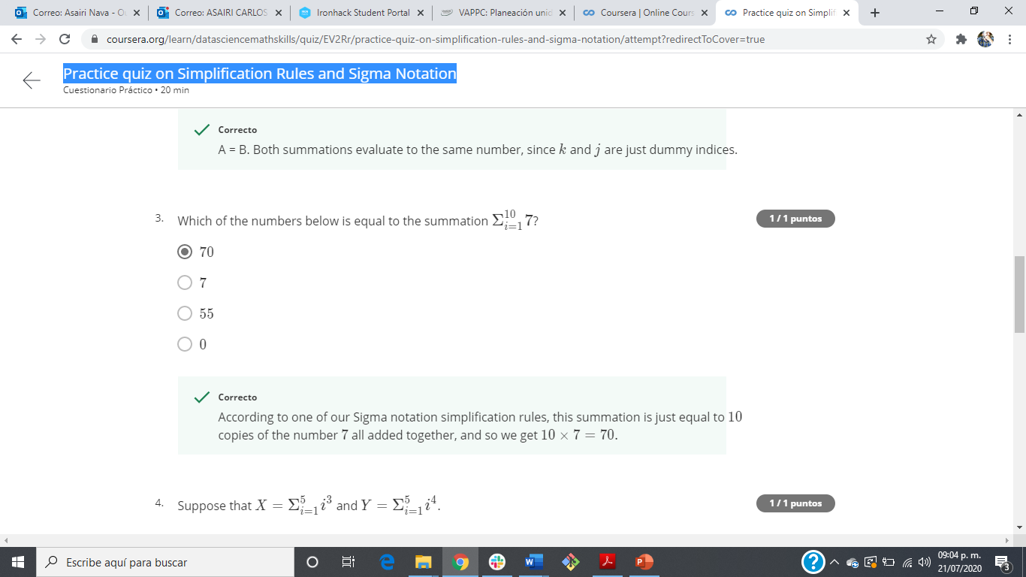
Practice quiz on Simplification Rules and Sigma Notation

Slide 16
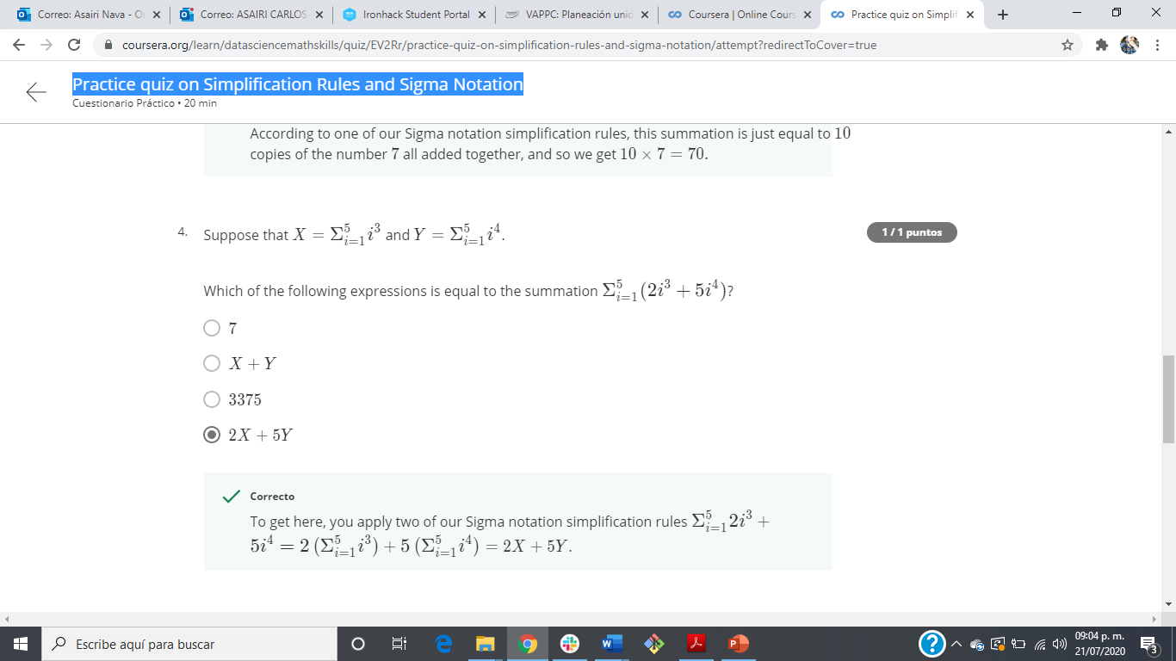
Practice quiz on Simplification Rules and Sigma Notation

Slide 17

Practice quiz on Simplification Rules and Sigma Notation

Slide 18
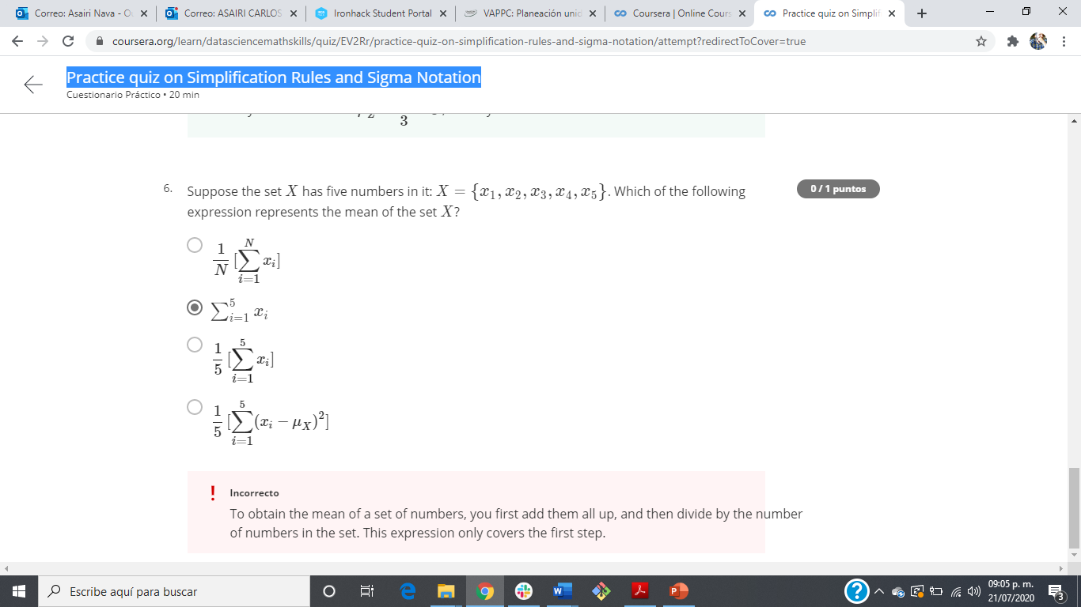
Practice quiz on Simplification Rules and Sigma Notation

Slide 19
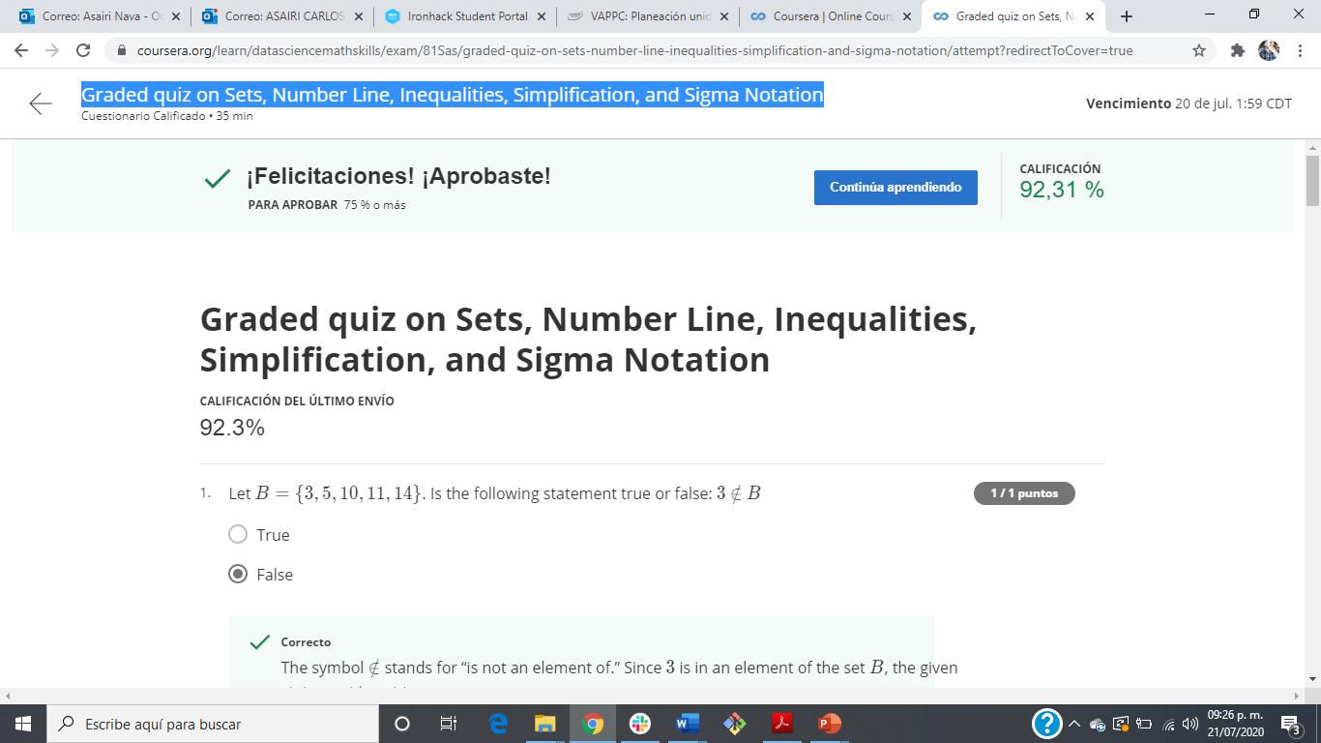
Graded quiz on Sets, Number Line, Inequalities, Simplification, and Sigma Notation

Slide 20
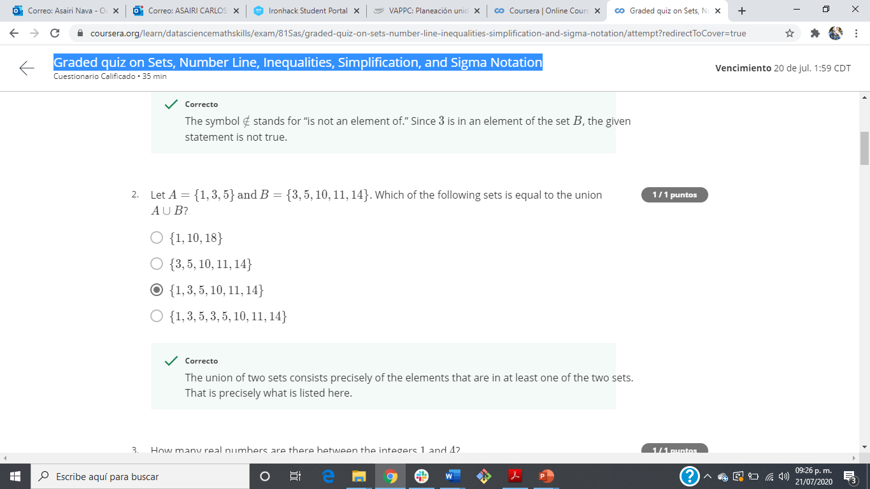
Graded quiz on Sets, Number Line, Inequalities, Simplification, and Sigma Notation

Slide 21
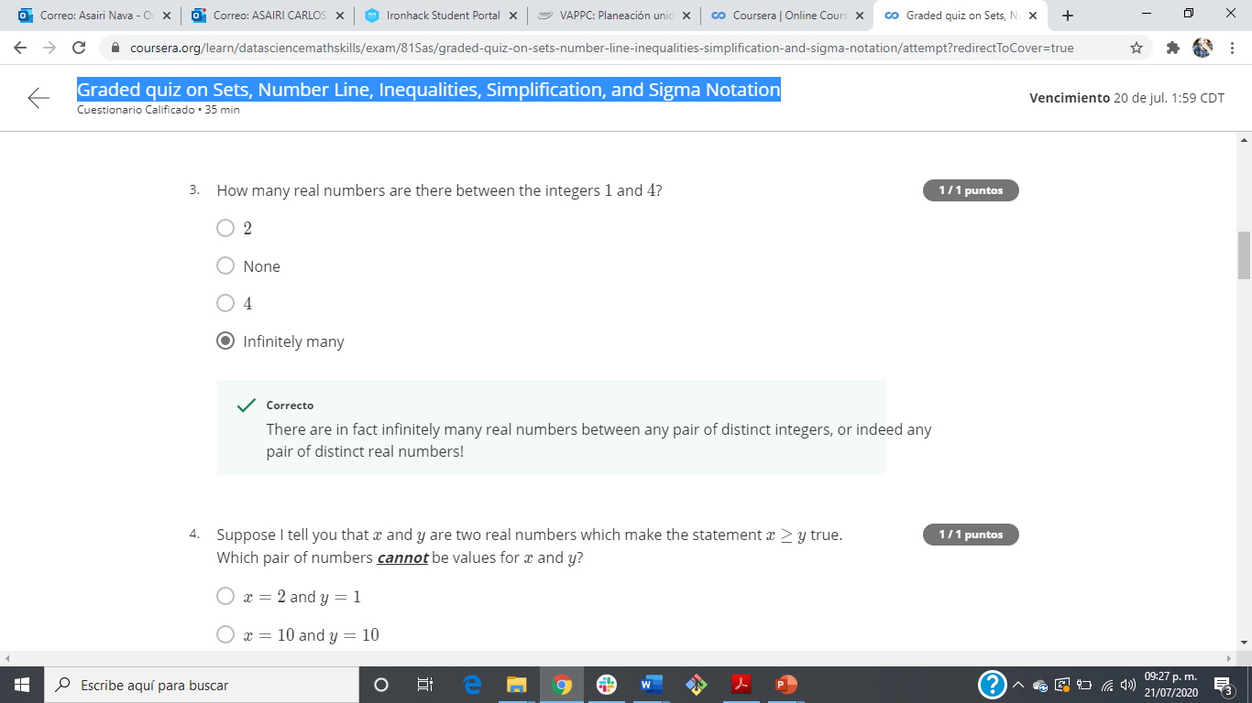
Graded quiz on Sets, Number Line, Inequalities, Simplification, and Sigma Notation

Slide 22
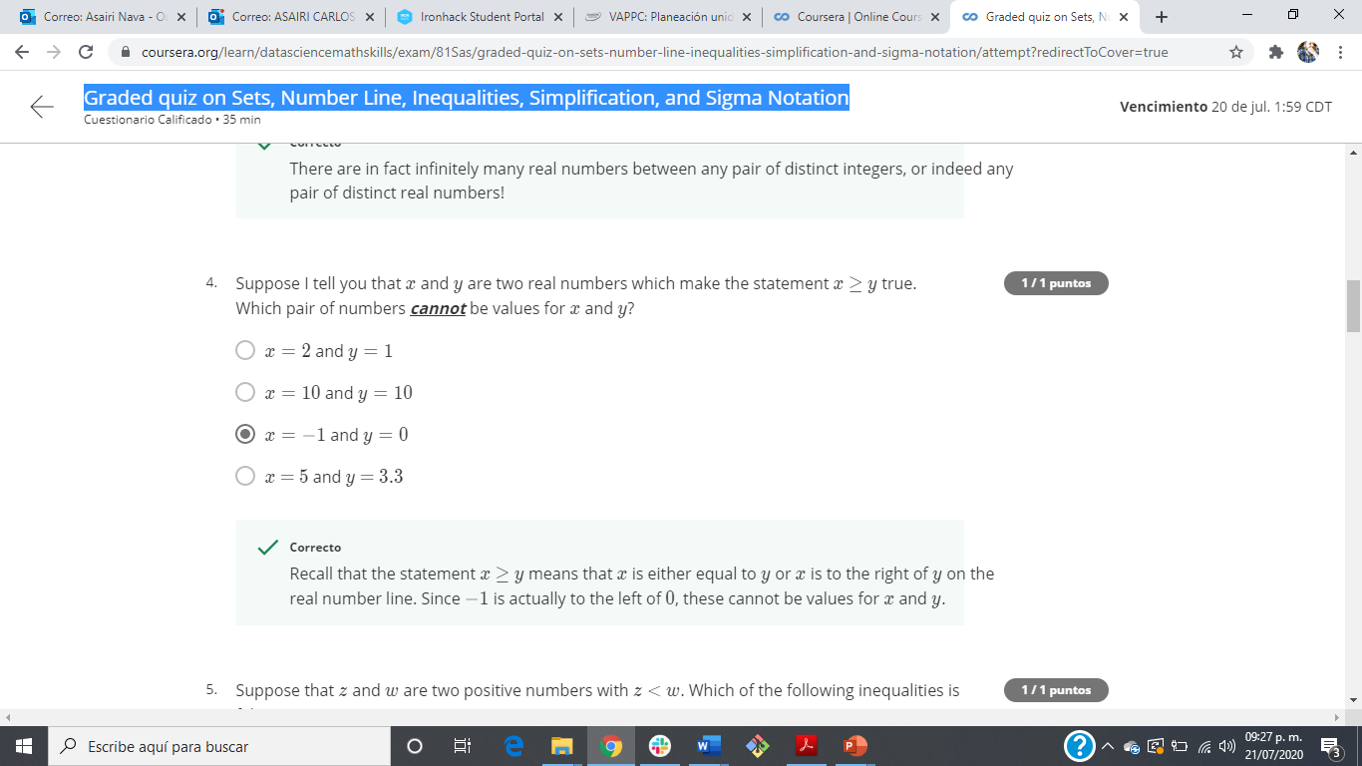
Graded quiz on Sets, Number Line, Inequalities, Simplification, and Sigma Notation

Slide 23

Graded quiz on Sets, Number Line, Inequalities, Simplification, and Sigma Notation

Slide 24
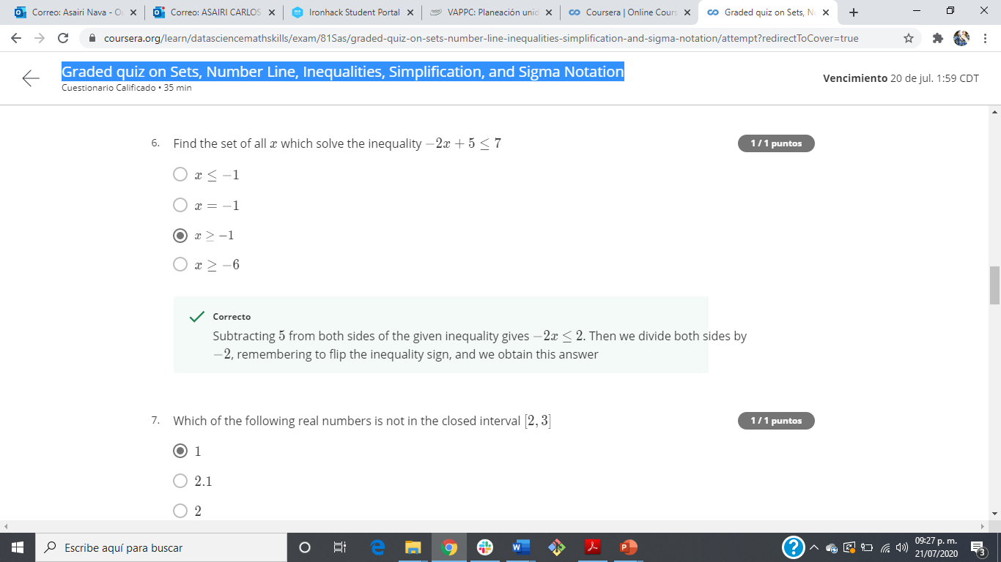
Graded quiz on Sets, Number Line, Inequalities, Simplification, and Sigma Notation

Slide 25
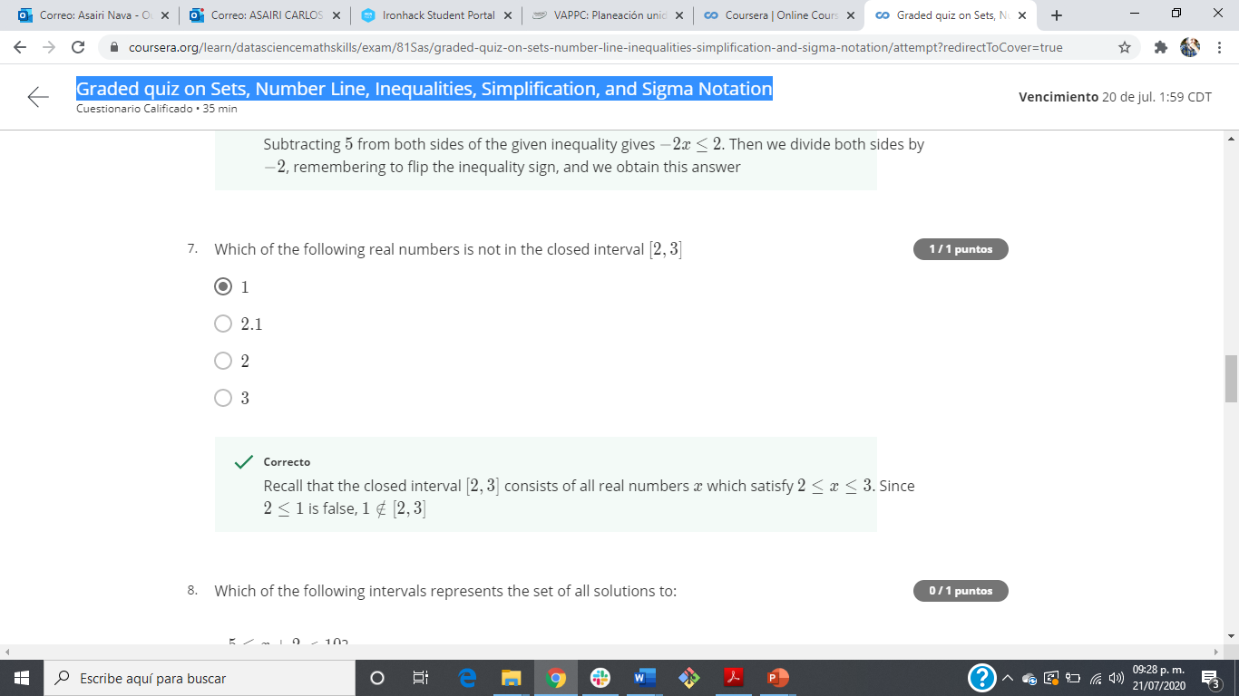
Graded quiz on Sets, Number Line, Inequalities, Simplification, and Sigma Notation

Slide 26
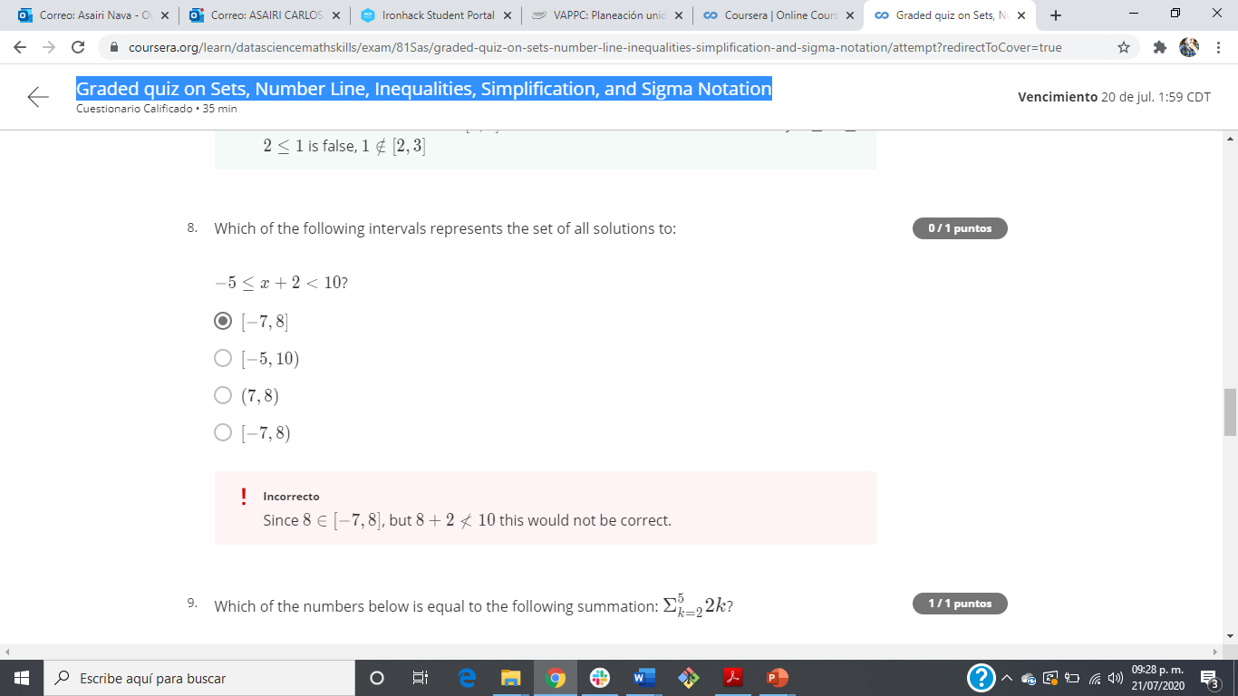
Graded quiz on Sets, Number Line, Inequalities, Simplification, and Sigma Notation

Slide 27
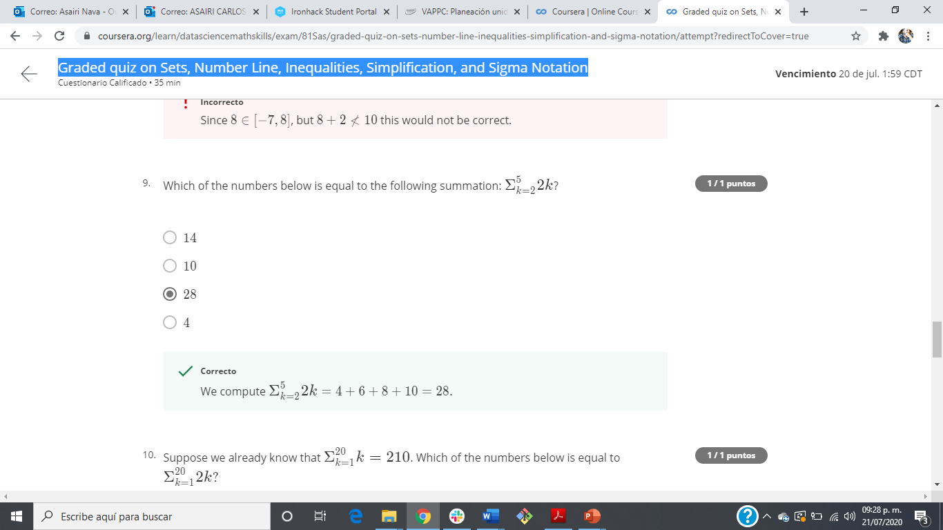
Graded quiz on Sets, Number Line, Inequalities, Simplification, and Sigma Notation

Slide 28
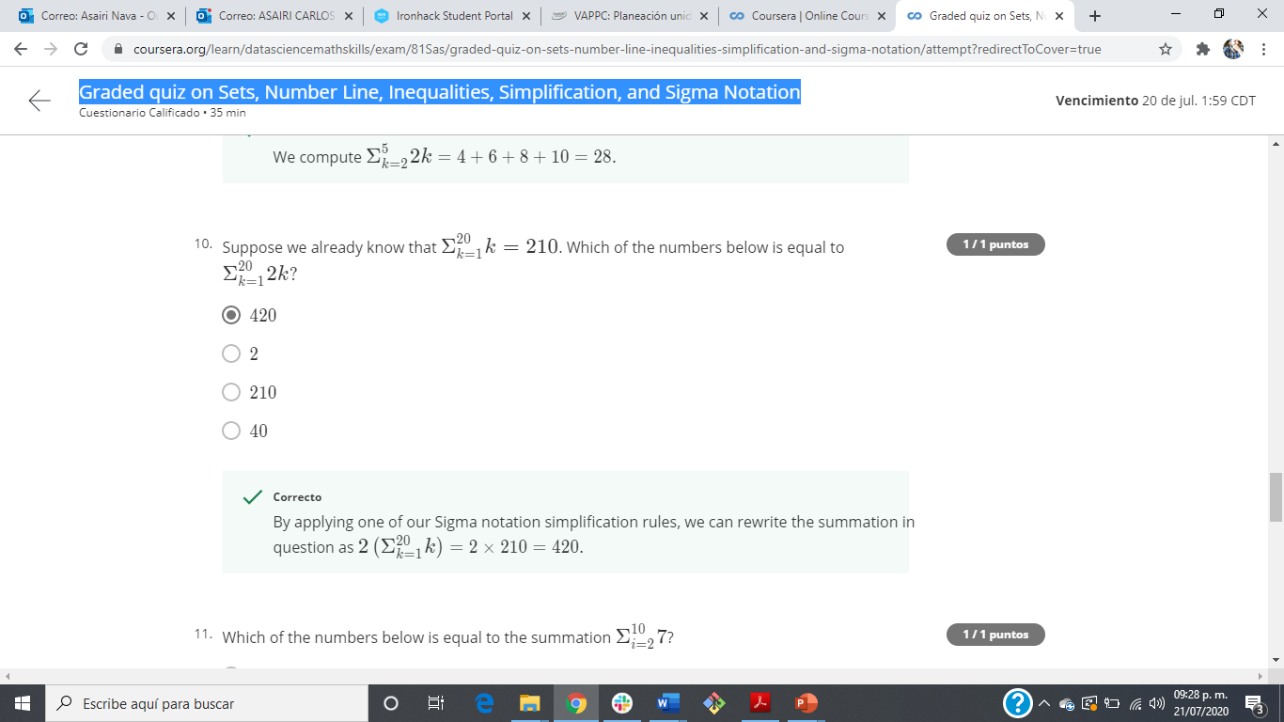
Graded quiz on Sets, Number Line, Inequalities, Simplification, and Sigma Notation

Slide 29

Graded quiz on Sets, Number Line, Inequalities, Simplification, and Sigma Notation

Slide 30
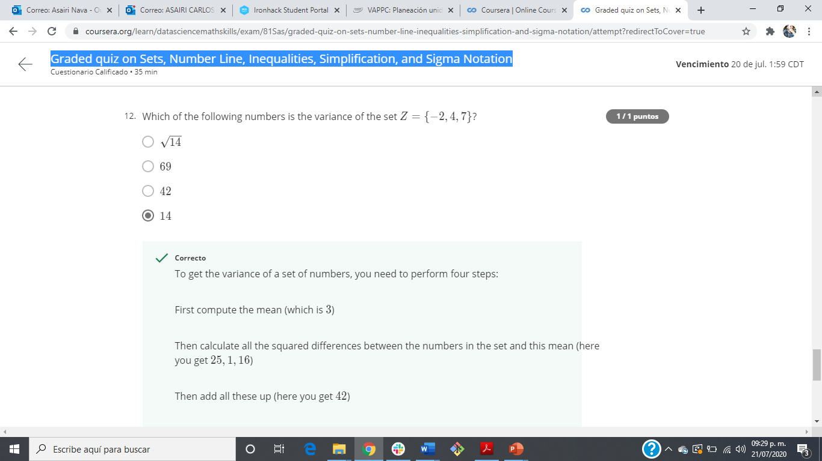
Graded quiz on Sets, Number Line, Inequalities, Simplification, and Sigma Notation

Slide 31
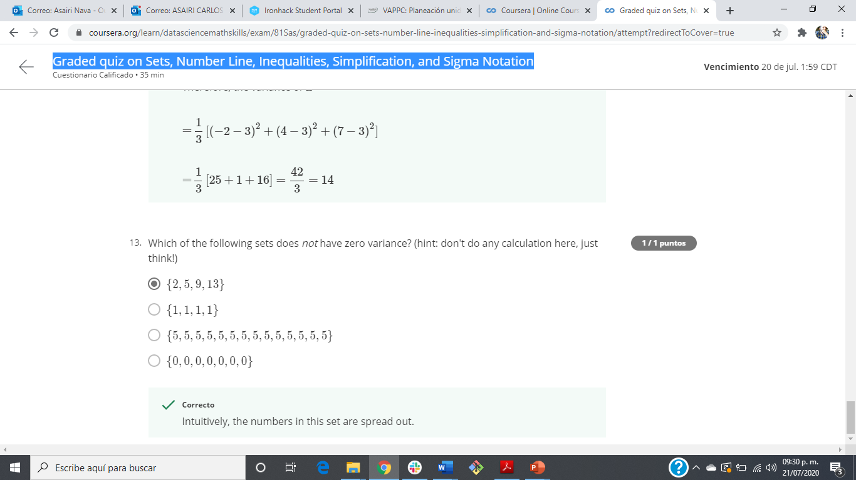
Graded quiz on Sets, Number Line, Inequalities, Simplification, and Sigma Notation

Slide 32
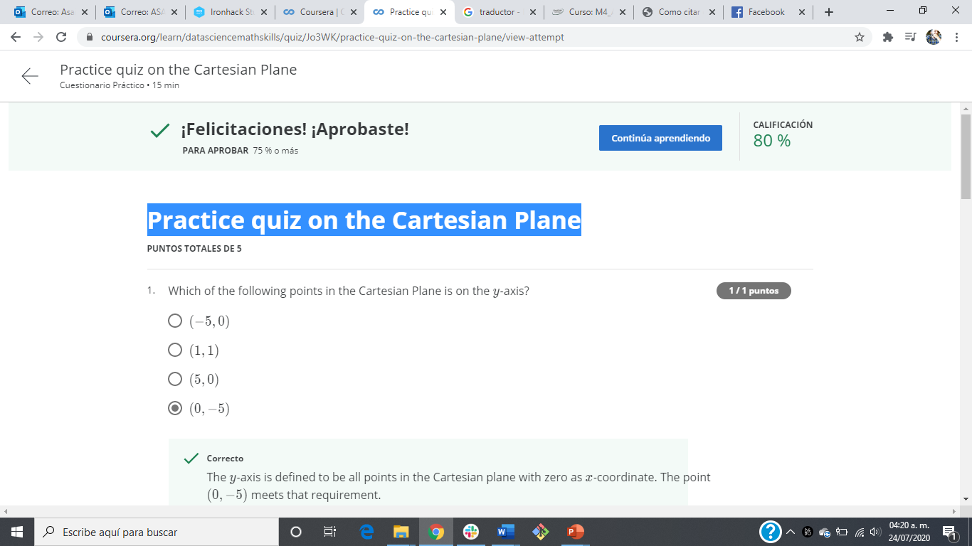
Practice quiz on the Cartesian Plane

Slide 33
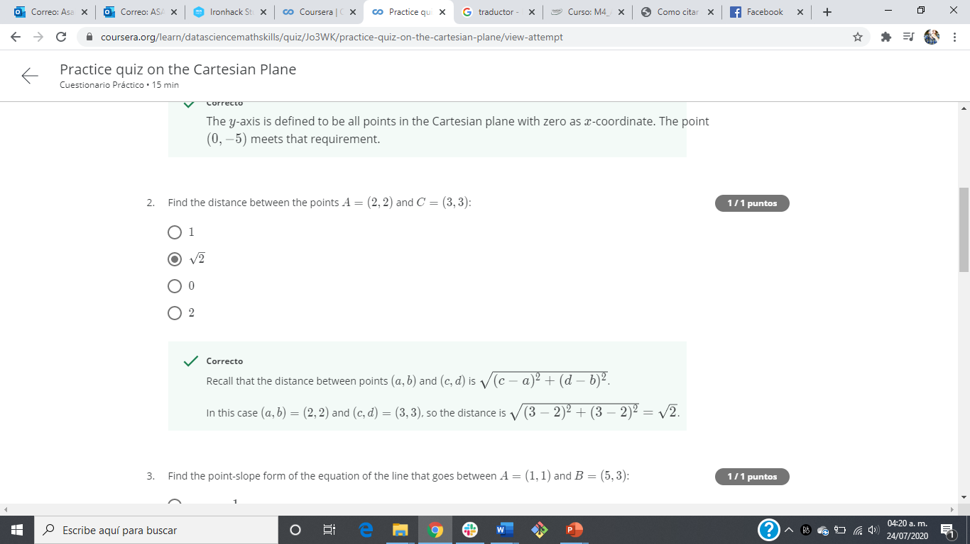
Practice quiz on the Cartesian Plane

Slide 34
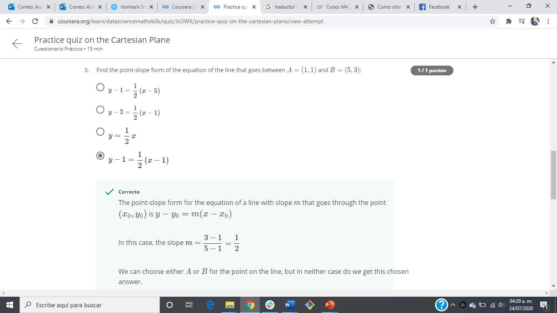
Practice quiz on the Cartesian Plane

Slide 35
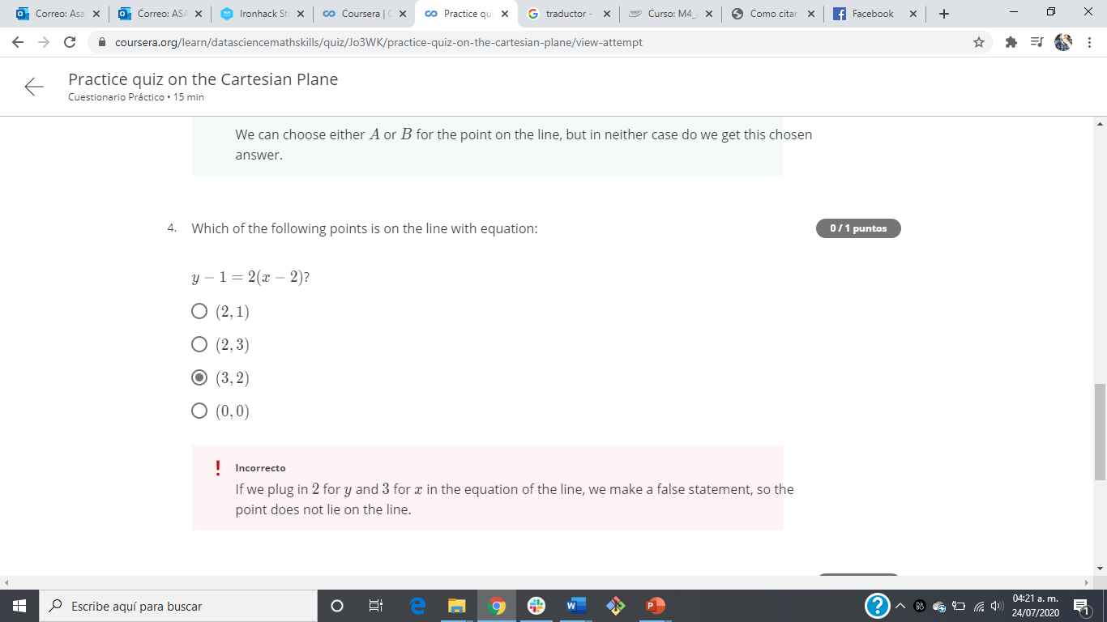
Practice quiz on the Cartesian Plane

Slide 36
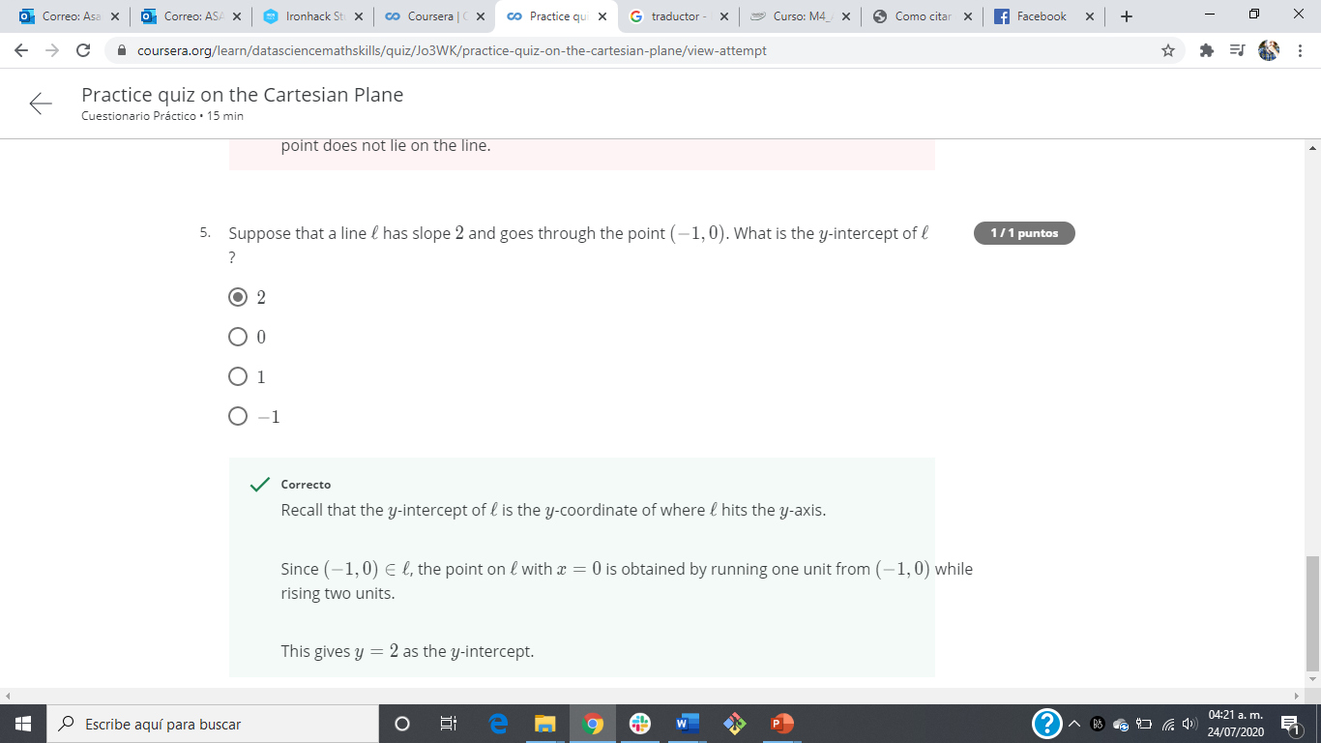
Practice quiz on the Cartesian Plane

Slide 37
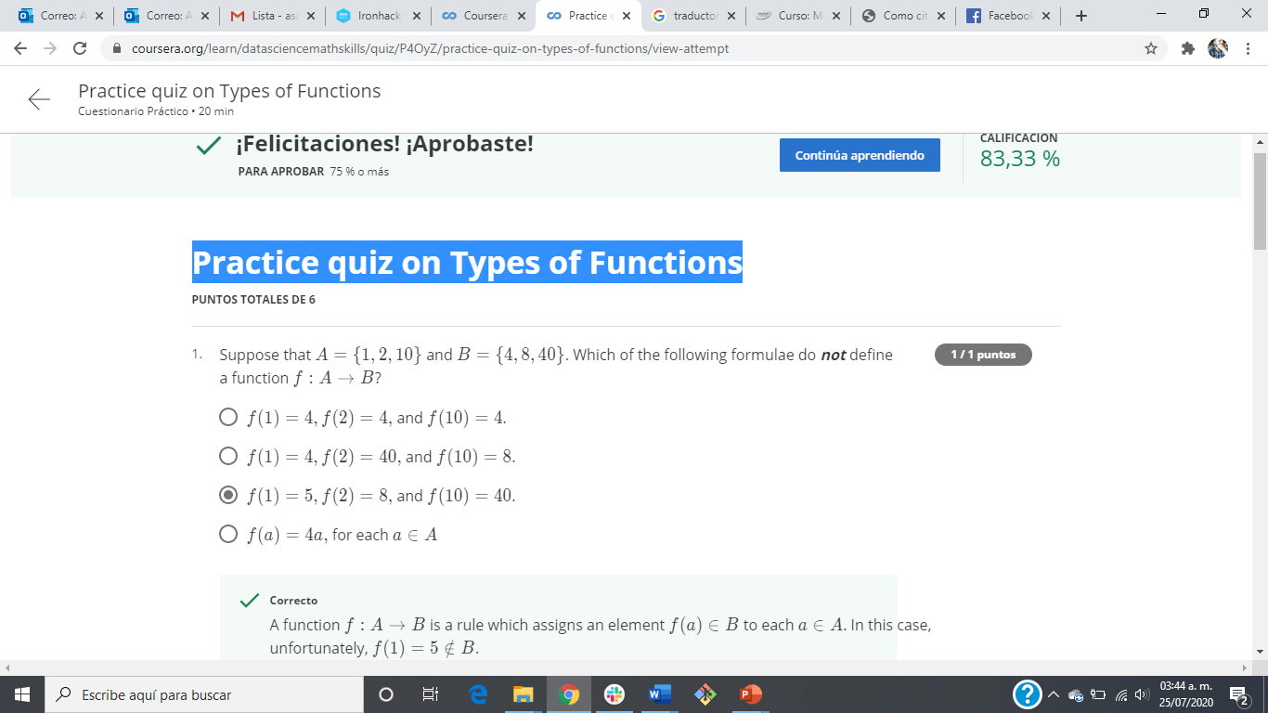
Practice quiz on Types of Functions

Slide 38
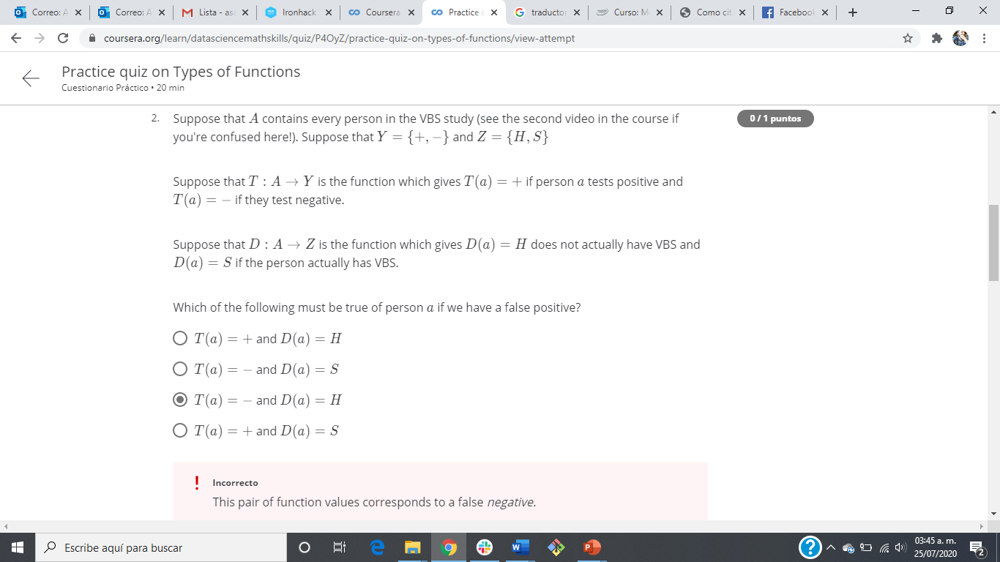
Practice quiz on Types of Functions

Slide 39
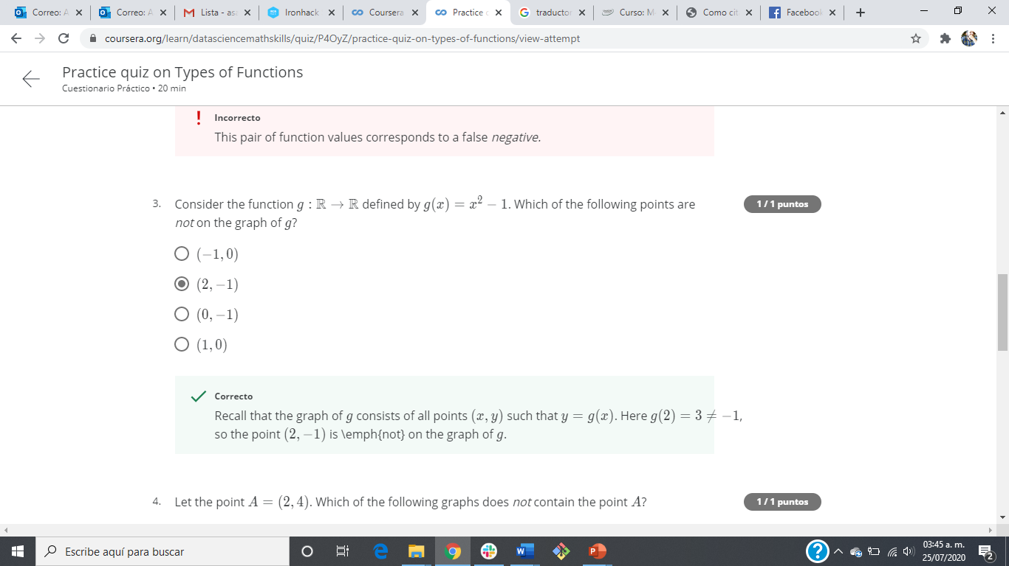
Practice quiz on Types of Functions

Slide 40
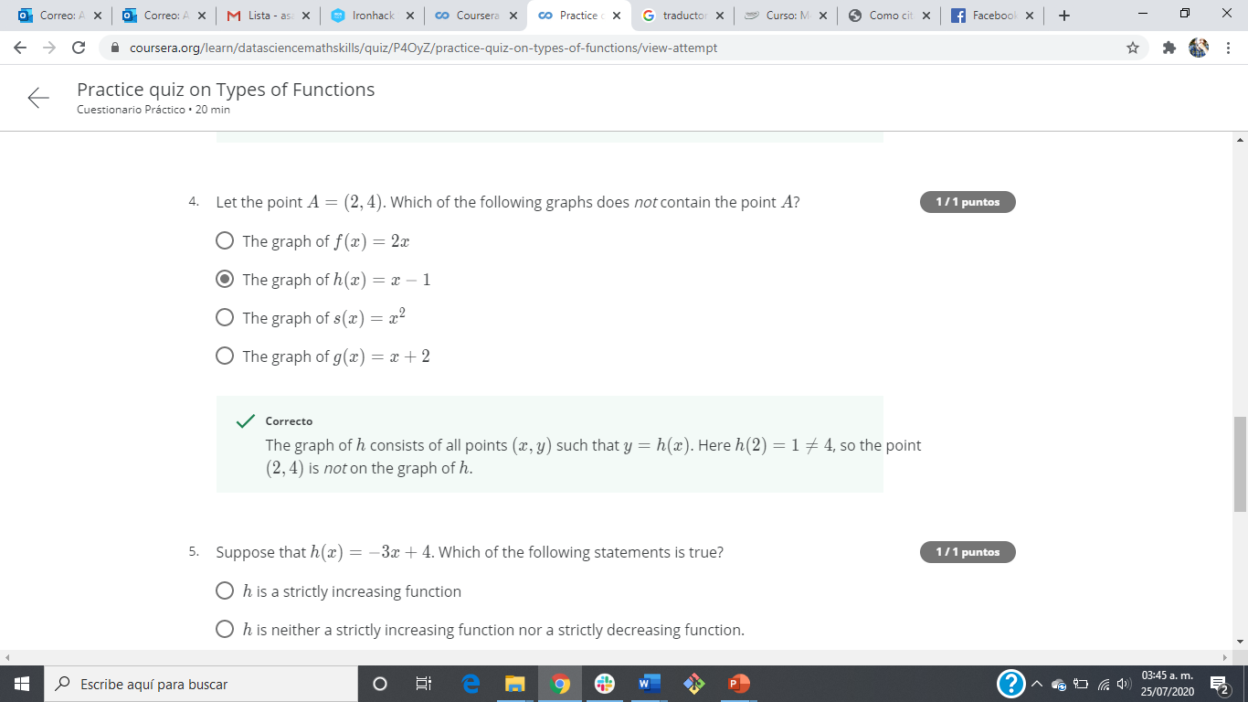
Practice quiz on Types of Functions

Slide 41
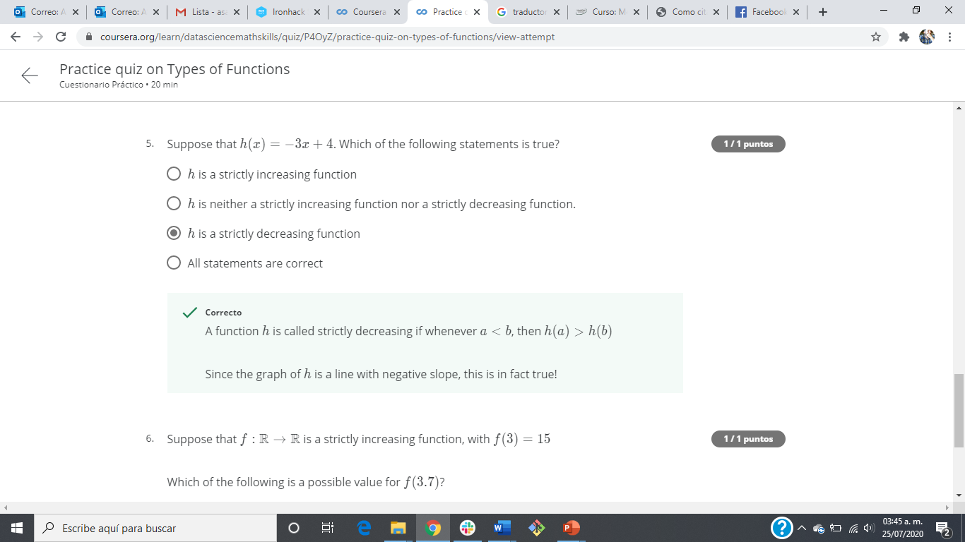
Practice quiz on Types of Functions

Slide 42
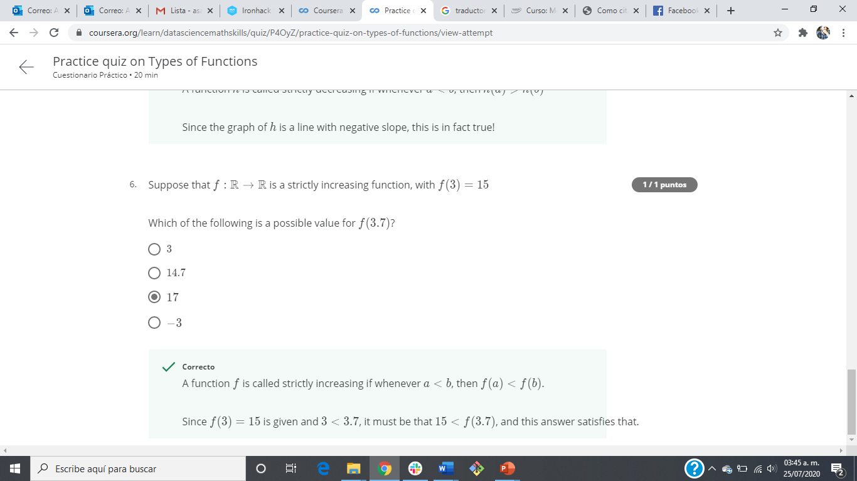
Practice quiz on Types of Functions

Slide 43
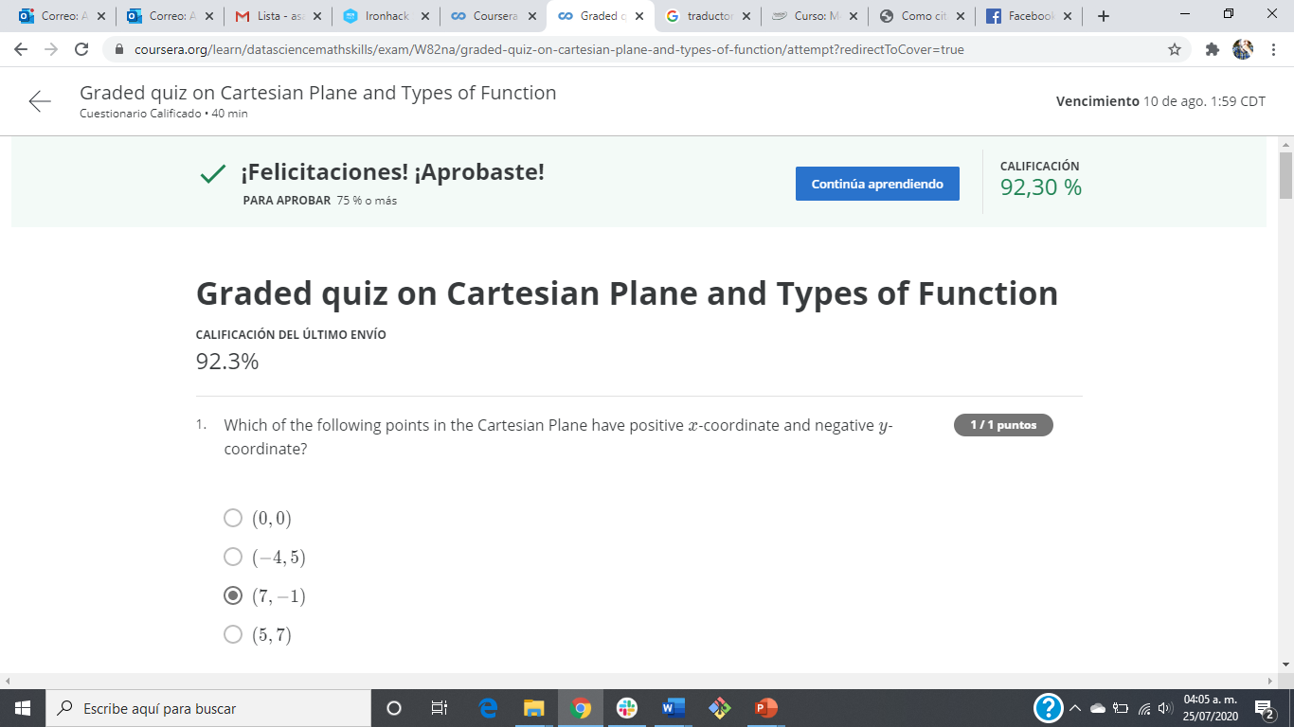
Graded quiz on Cartesian Plane and Types of Function

Slide 44
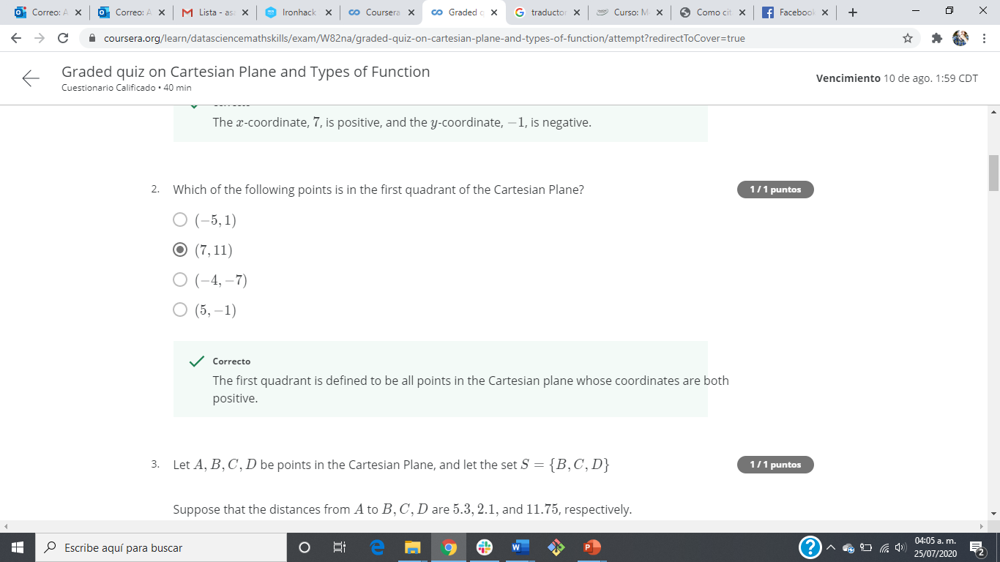
Graded quiz on Cartesian Plane and Types of Function

Slide 45
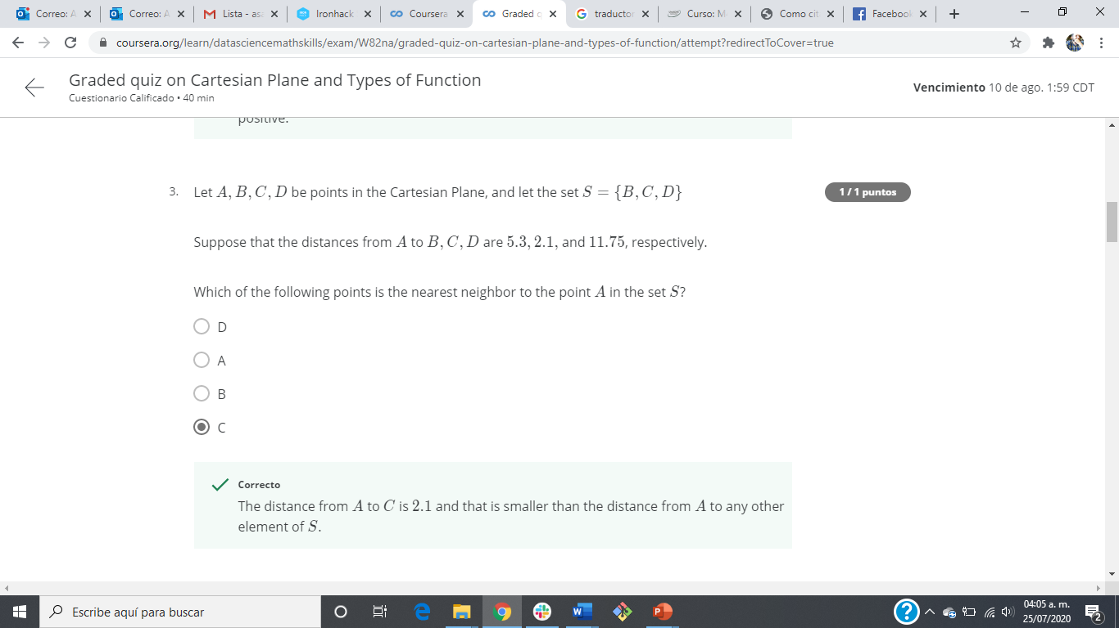
Graded quiz on Cartesian Plane and Types of Function

Slide 46
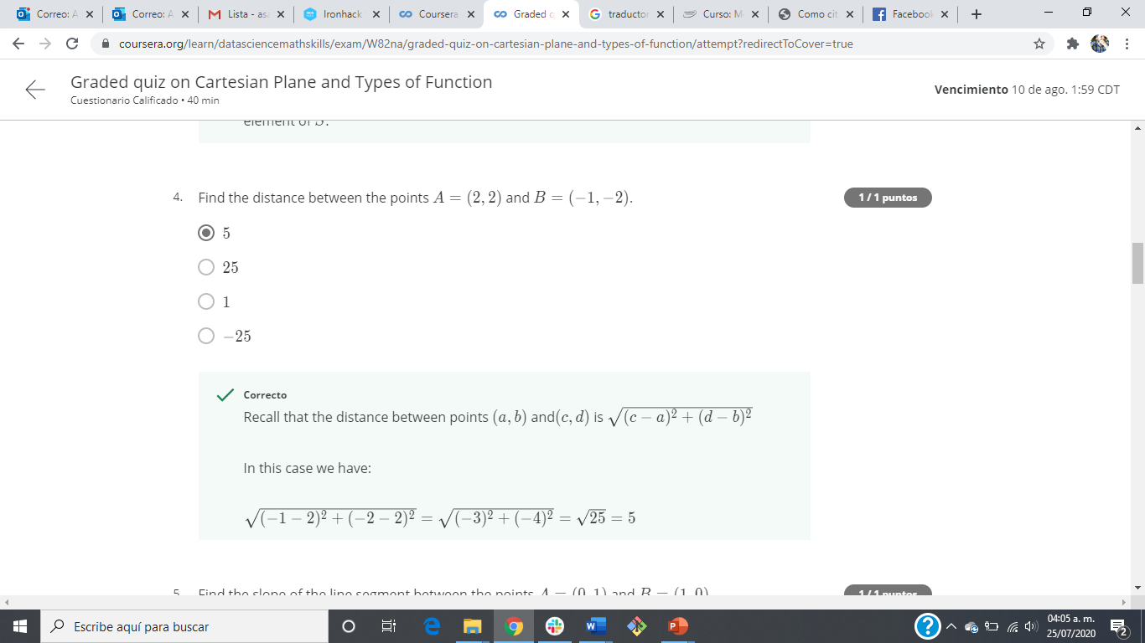
Graded quiz on Cartesian Plane and Types of Function

Slide 47

Graded quiz on Cartesian Plane and Types of Function

Slide 48
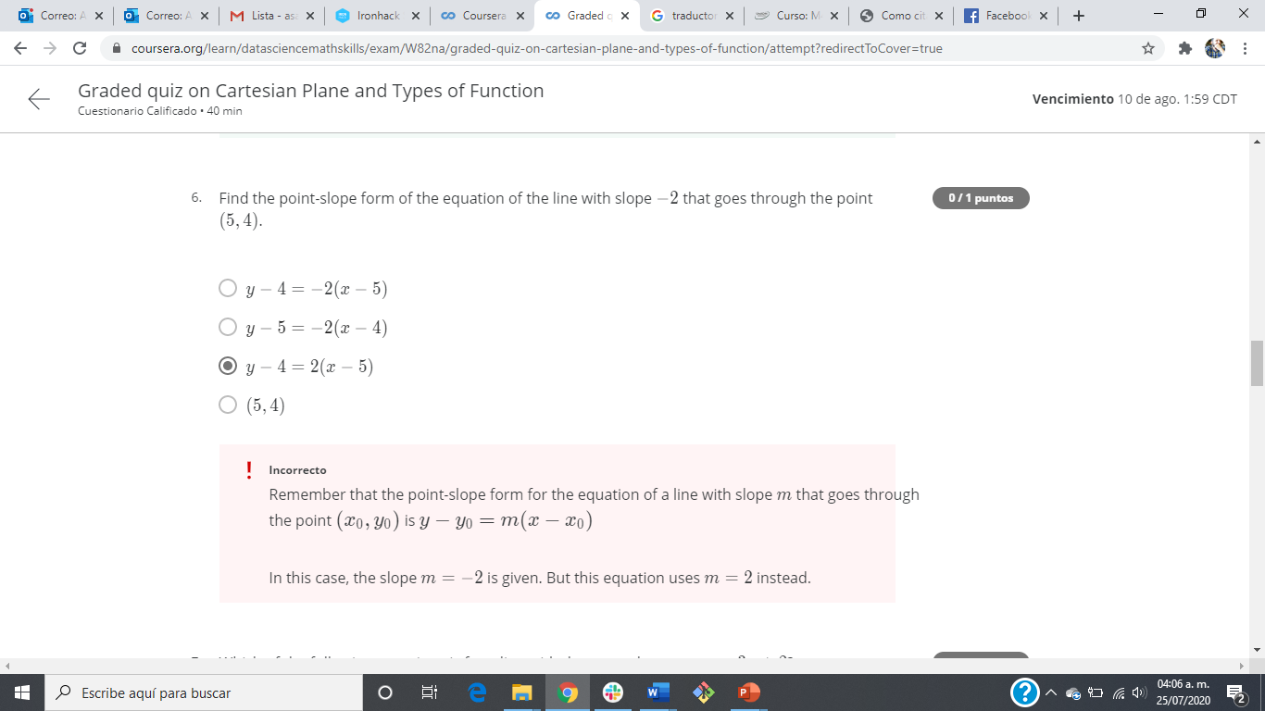
Graded quiz on Cartesian Plane and Types of Function

Slide 49
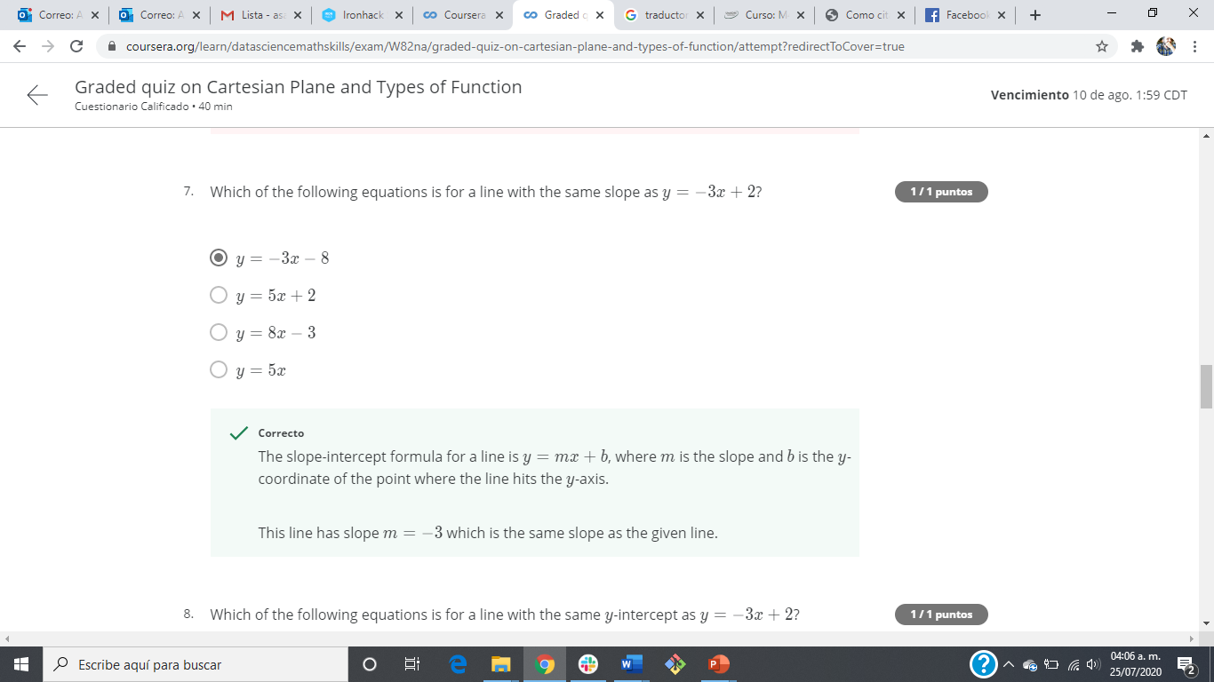
Graded quiz on Cartesian Plane and Types of Function

Slide 50

Graded quiz on Cartesian Plane and Types of Function

Slide 51
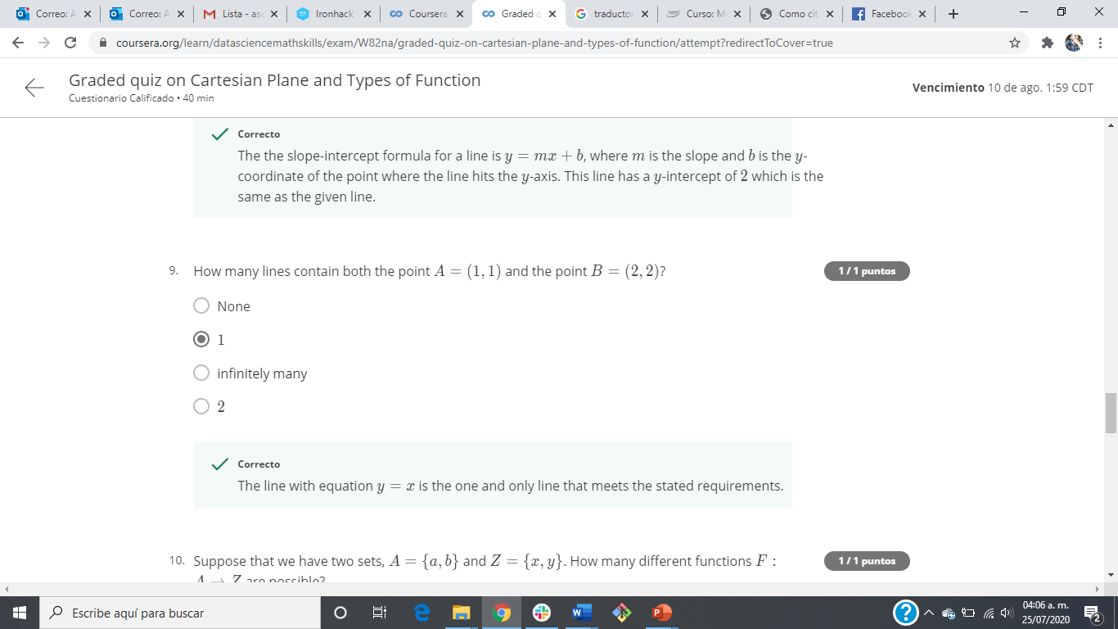
Graded quiz on Cartesian Plane and Types of Function

Slide 52
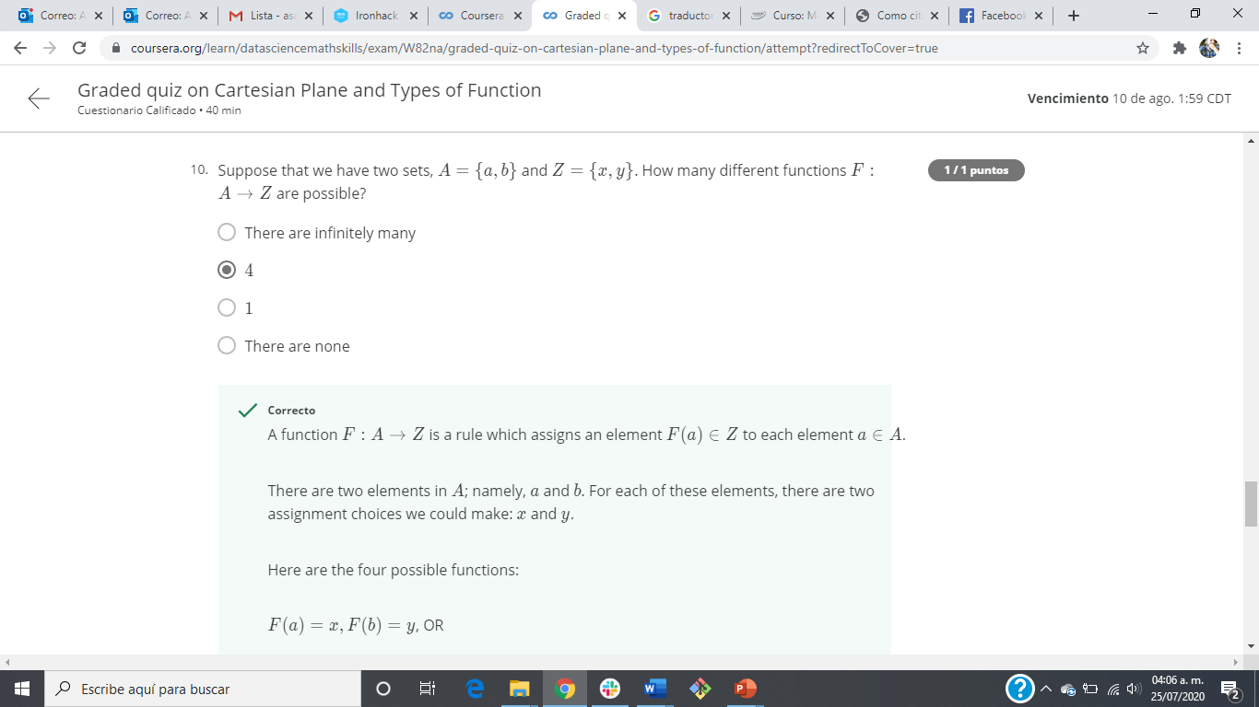
Graded quiz on Cartesian Plane and Types of Function

Slide 53
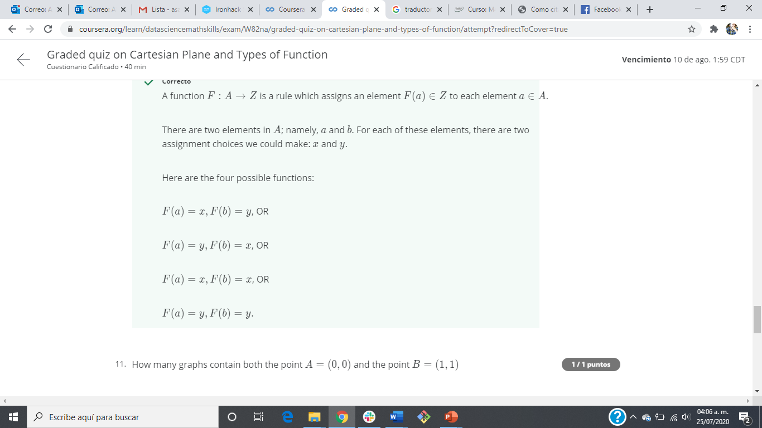
Graded quiz on Cartesian Plane and Types of Function

Slide 54
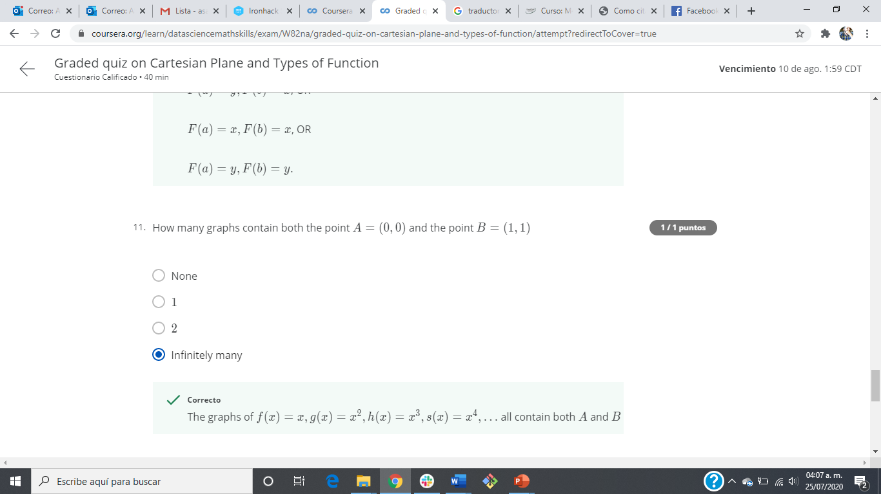
Graded quiz on Cartesian Plane and Types of Function

Slide 55
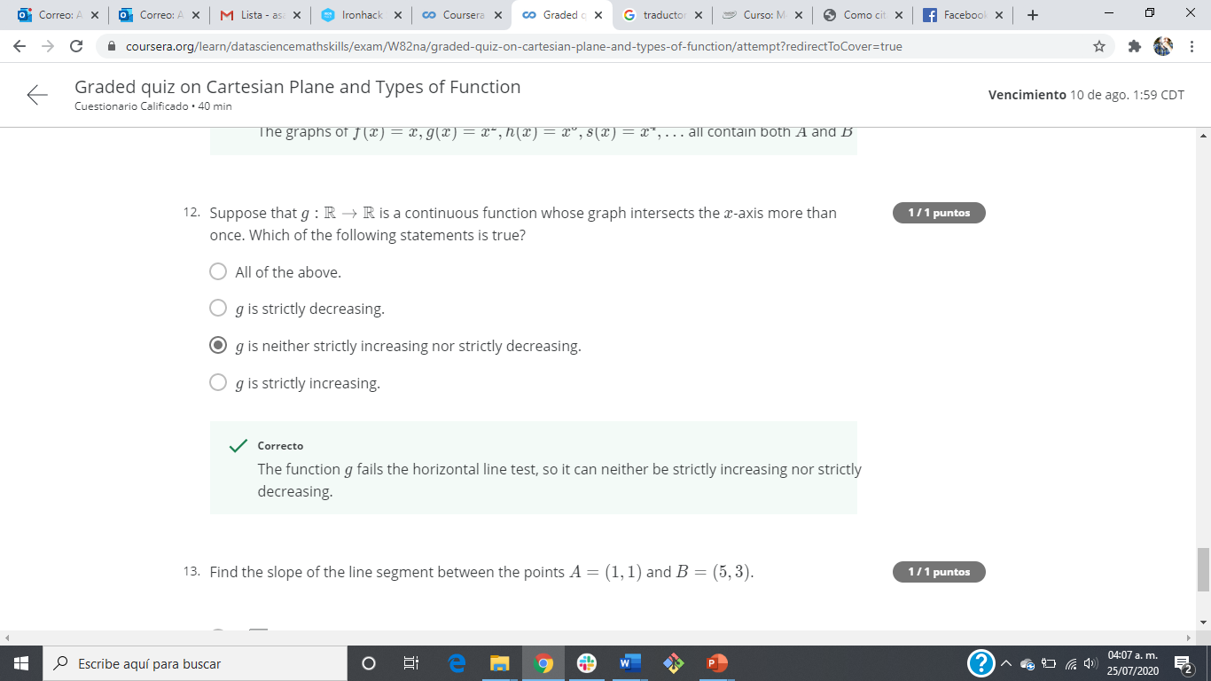
Graded quiz on Cartesian Plane and Types of Function

Slide 56
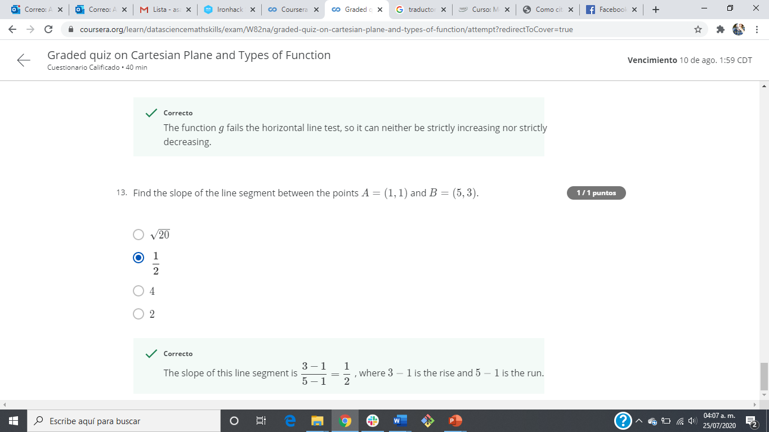
Graded quiz on Cartesian Plane and Types of Function

Slide 57
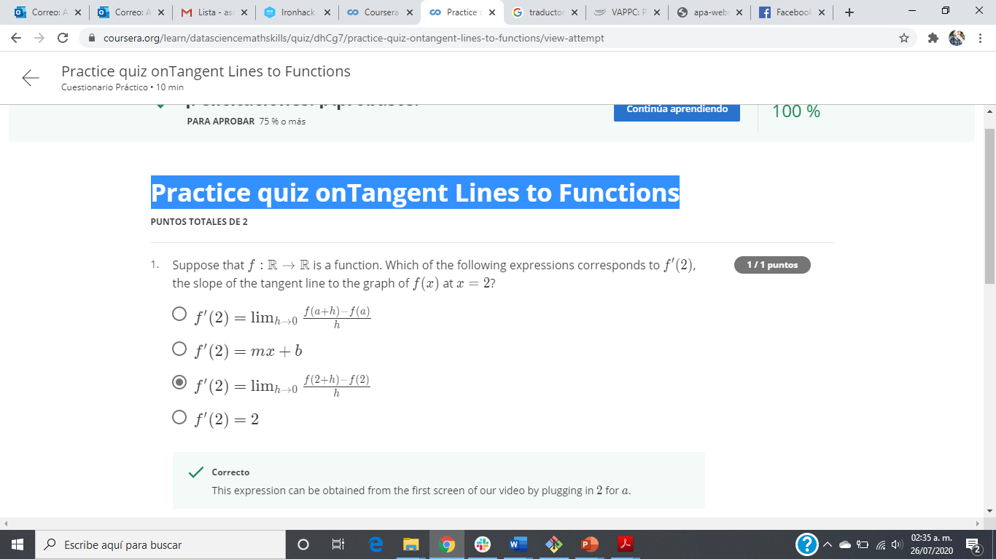
Practice quiz onTangent Lines to Functions

Slide 58
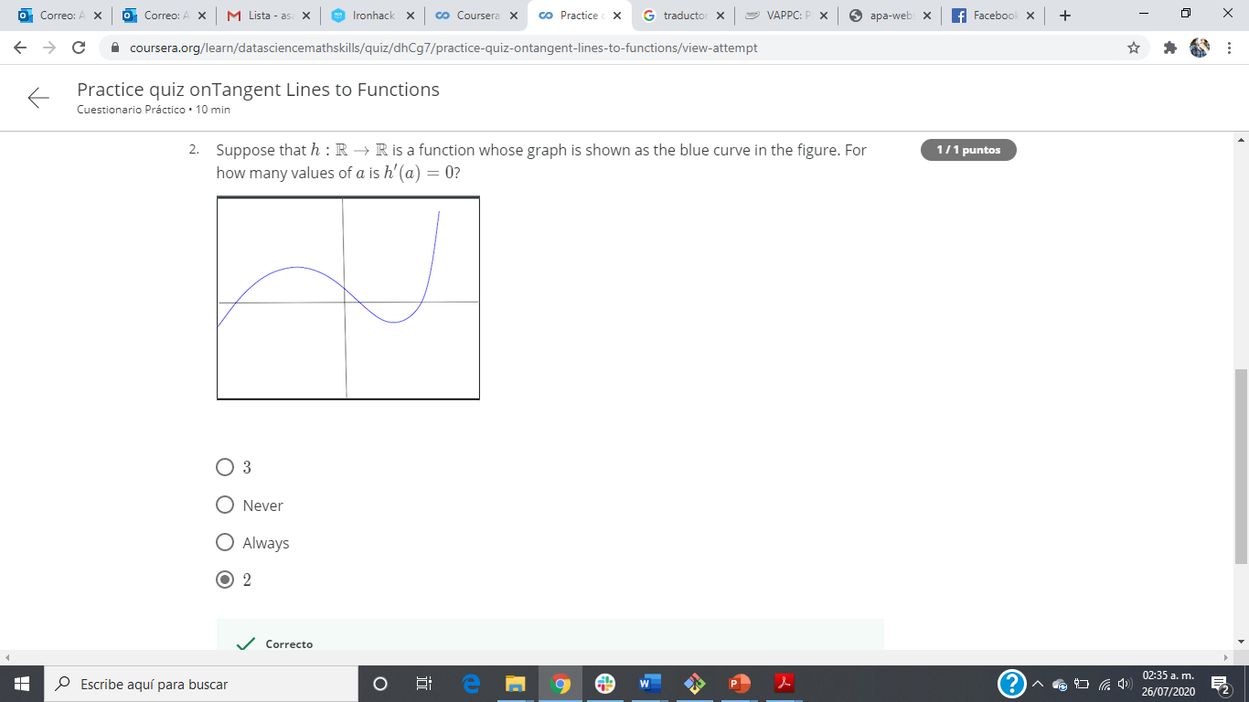
Practice quiz onTangent Lines to Functions

Slide 59

Practice quiz onTangent Lines to Functions

Slide 60

Practice quiz on Exponents and Logarithms

Slide 61

Practice quiz on Exponents and Logarithms

Slide 62

Practice quiz on Exponents and Logarithms

Slide 63

Practice quiz on Exponents and Logarithms

Slide 64

Practice quiz on Exponents and Logarithms

Slide 65

Practice quiz on Exponents and Logarithms

Slide 66

Practice quiz on Exponents and Logarithms

Slide 67

Practice quiz on Exponents and Logarithms

Slide 68

Practice quiz on Exponents and Logarithms

Slide 69

Practice quiz on Exponents and Logarithms

Slide 70

Practice quiz on Exponents and Logarithms

Slide 71

Practice quiz on Exponents and Logarithms

Slide 72

Practice quiz on Exponents and Logarithms

Slide 73

Practice quiz on Exponents and Logarithms

Slide 74

Graded quiz on Tangent Lines to Functions, Exponents and Logarithms

Slide 75

Graded quiz on Tangent Lines to Functions, Exponents and Logarithms

Slide 76

Graded quiz on Tangent Lines to Functions, Exponents and Logarithms

Slide 77

Graded quiz on Tangent Lines to Functions, Exponents and Logarithms

Slide 78

Graded quiz on Tangent Lines to Functions, Exponents and Logarithms

Slide 79

Graded quiz on Tangent Lines to Functions, Exponents and Logarithms

Slide 80

Graded quiz on Tangent Lines to Functions, Exponents and Logarithms

Slide 81

Graded quiz on Tangent Lines to Functions, Exponents and Logarithms

Slide 82
Graded quiz on Tangent Lines to Functions, Exponents and Logarithms

Slide 83

Graded quiz on Tangent Lines to Functions, Exponents and Logarithms

Slide 84

Graded quiz on Tangent Lines to Functions, Exponents and Logarithms

Slide 85

Graded quiz on Tangent Lines to Functions, Exponents and Logarithms

Slide 86

Graded quiz on Tangent Lines to Functions, Exponents and Logarithms

Slide 87

Graded quiz on Tangent Lines to Functions, Exponents and Logarithms

Slide 88

Graded quiz on Tangent Lines to Functions, Exponents and Logarithms

Slide 89

Graded quiz on Tangent Lines to Functions, Exponents and Logarithms

Slide 90

Graded quiz on Tangent Lines to Functions, Exponents and Logarithms

Slide 91

Practice quiz on Probability Concept

Slide 92

Practice quiz on Probability Concept

Slide 93

Practice quiz on Probability Concept

Slide 94

Practice quiz on Probability Concept

Slide 95

Practice quiz on Probability Concept

Slide 96

Practice quiz on Probability Concept

Slide 97

Practice quiz on Probability Concept

Slide 98

Practice quiz on Probability Concept

Slide 99

Practice quiz on Probability Concept

Slide 100

Problem Solving Methods

Slide 101

Problem Solving Methods

Slide 102

Problem Solving Methods

Slide 103

Problem Solving Methods

Slide 104

Problem Solving Methods

Slide 105

Problem Solving Methods

Slide 106

Problem Solving Methods

Slide 107

Problem Solving Methods

Slide 108

Problem Solving Methods

Slide 109

Problem Solving Methods

Slide 110

Problem Solving Methods

Slide 111

Problem Solving Methods

Slide 112

Problem Solving Methods

Slide 113

Problem Solving Methods

Slide 114

Practice quiz on Bayes Theorem and the Binomial Theorem

Slide 115

Practice quiz on Bayes Theorem and the Binomial Theorem

Slide 116
Practice quiz on Bayes Theorem and the Binomial Theorem

Slide 117

Practice quiz on Bayes Theorem and the Binomial Theorem

Slide 118

Practice quiz on Bayes Theorem and the Binomial Theorem

Slide 119

Practice quiz on Bayes Theorem and the Binomial Theorem

Slide 120

Practice quiz on Bayes Theorem and the Binomial Theorem

Slide 121

Practice quiz on Bayes Theorem and the Binomial Theorem

Slide 122

Practice quiz on Bayes Theorem and the Binomial Theorem

Slide 123

Practice quiz on Bayes Theorem and the Binomial Theorem

Slide 124

Practice quiz on Bayes Theorem and the Binomial Theorem

Slide 125

Practice quiz on Bayes Theorem and the Binomial Theorem

Slide 126

Practice quiz on Bayes Theorem and the Binomial Theorem

Slide 127

Practice quiz on Bayes Theorem and the Binomial Theorem

Slide 128

Practice quiz on Bayes Theorem and the Binomial Theorem

Slide 129

Practice quiz on Bayes Theorem and the Binomial Theorem

Slide 130

Probability (basic and Intermediate) Graded Quiz

Slide 131

Probability (basic and Intermediate) Graded Quiz

Slide 132

Probability (basic and Intermediate) Graded Quiz

Slide 133

Probability (basic and Intermediate) Graded Quiz

Slide 134

Probability (basic and Intermediate) Graded Quiz

Slide 135

Probability (basic and Intermediate) Graded Quiz

Slide 136

Probability (basic and Intermediate) Graded Quiz

